Slide 1
Kenya
Natural and Human-Made Features
Young Geographers
MP 3 – Grade 1
Updated by Melissa McDonald, MLS

Slide 2
Natural Features
Young Geographers Travel to Kenya

Slide 3
The red band has white border on its two sides. These three bands are horizontally equal to each other. In the middle of the flag there is a Maasai warrior shield with two spears.
National Geographic for Kids Kenyan Flag
Notes:
http://www.mapsofworld.com/flags/kenya-flag.html
http://kids.nationalgeographic.com/kids/places/find/kenya/
http://travel.nationalgeographic.com/travel/countries/kenya-facts/

Slide 4
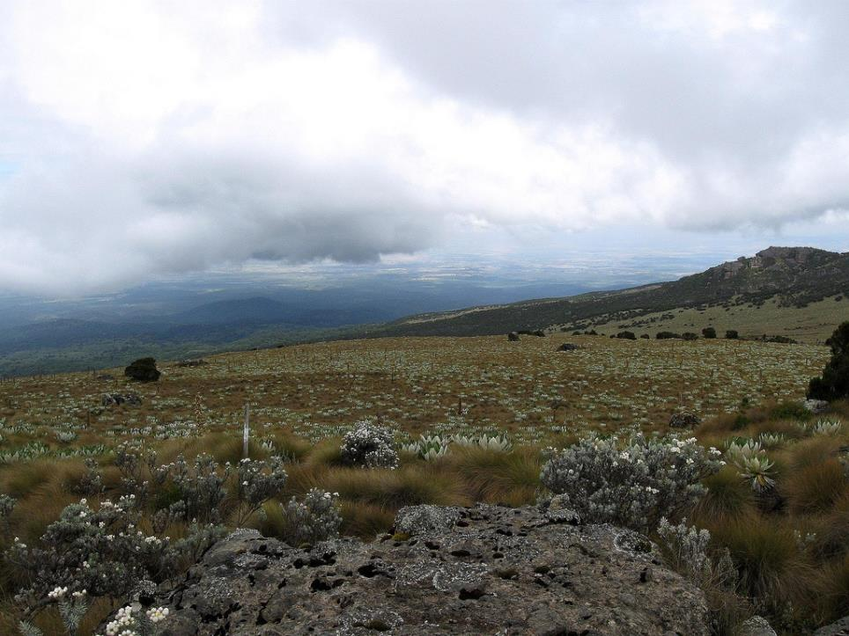
Chogoria
Notes:
Kenya_ Chogoria
http://www.flickr.com/photos/aiace/3210403325/in/set-72157612498560932/

Slide 5
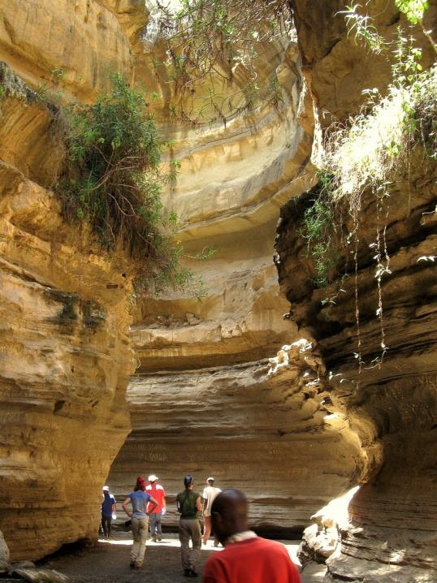
Gorges Naivasha
A gorge is a deep, narrow valley with steep sides
Notes:
Kenya_ gorges_Naivasha
http://www.flickr.com/photos/aiace/3213107001/in/set-72157612498560932/

Slide 6
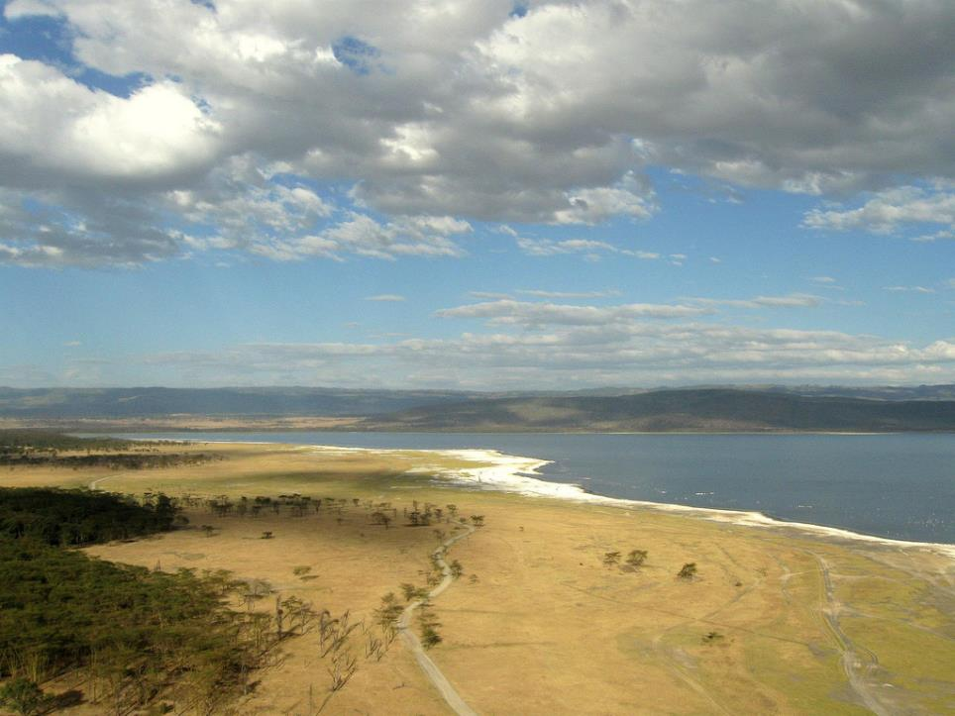
Lake Nakuru
Notes:
Kenya_ Lake_Nakuru
http://www.flickr.com/photos/aiace/3213102307/in/set-72157612498560932/

Slide 7
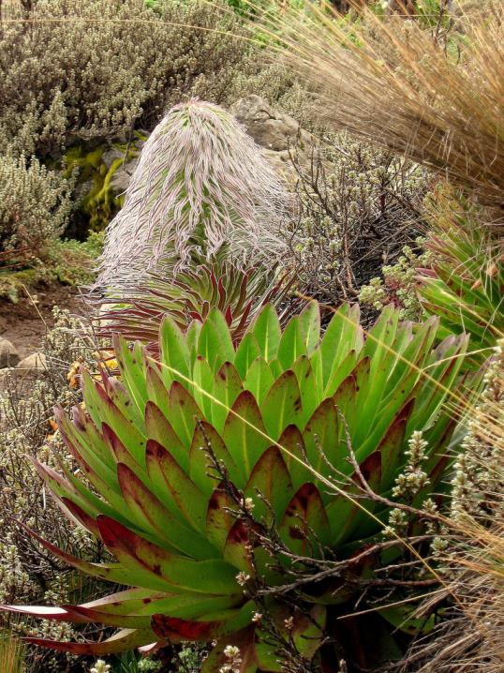
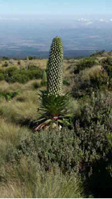
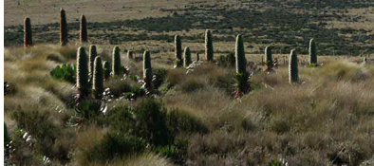
Lobelia
Notes:
Kenya_ Lobelia
http://www.flickr.com/photos/aiace/3210405067/in/set-72157612498560932/
Giant Lobelia
http://www.markhorrell.com/travel/kenya/mtkenya/lobelia.html
http://www.markhorrell.com/travel/kenya/mtkenya/barrow.html

Slide 8
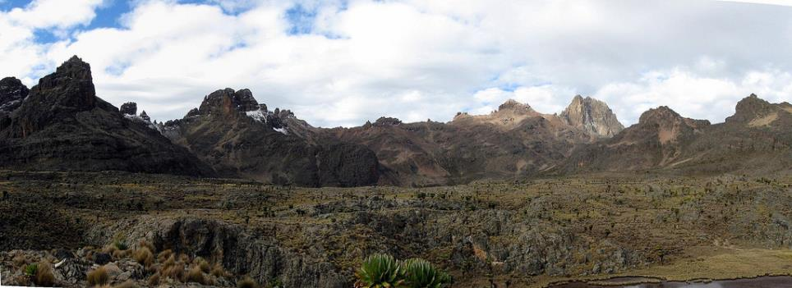
Mount Kenya
Notes:
Kenya_ Minto's_panorama
http://www.flickr.com/photos/aiace/3211279798/in/set-72157612498560932/

Slide 9
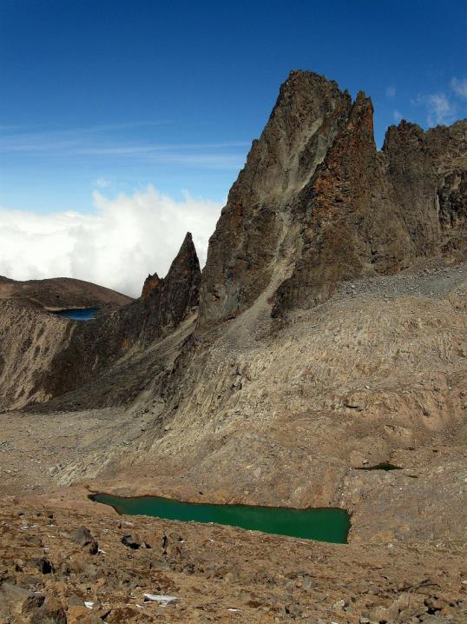
Point St. John
Notes:
Kenya_ Point_St John_ Lewis_tarn
http://www.flickr.com/photos/aiace/3211253344/in/set-72157612498560932/

Slide 10
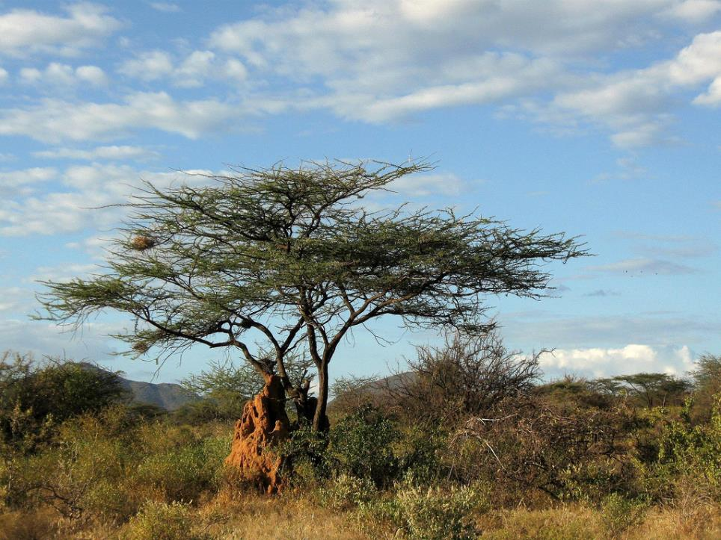
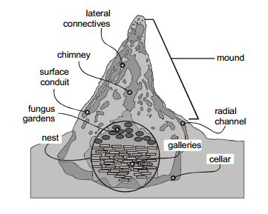
Acacia Tree
Guide to Trees in Kenya
Notes:
Kenya_acacia_termite_nest
http://www.flickr.com/photos/aiace/3213027793/in/set-72157612498560932/
Termite mounds and the ecosystem:
http://www.esf.edu/EFB/TURNER/publication%20pdfs/Ecohydrology.pdf
Guide to Trees in Kenya
http://agroforesttrees.cisat.jmu.edu/

Slide 11
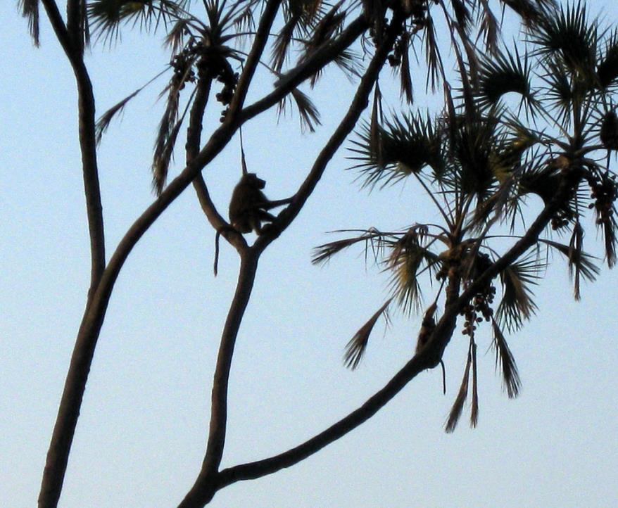
Baboon - Britannica School
Notes:
Kenya_babus
http://www.flickr.com/photos/aiace/3213870478/in/set-72157612498560932/
Britannica School Article: http://school.eb.com/levels/elementary/article/352811
Kenya - wild animals
http://www.experiencekenya.co.ke/wild_animals.php

Slide 12
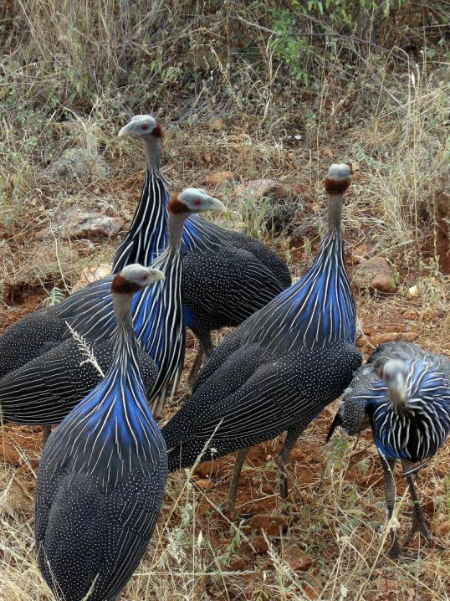
Blue Turkeys
Notes:
Kenya_blue_turkeys
http://www.flickr.com/photos/aiace/3213030633/in/set-72157612498560932/

Slide 13
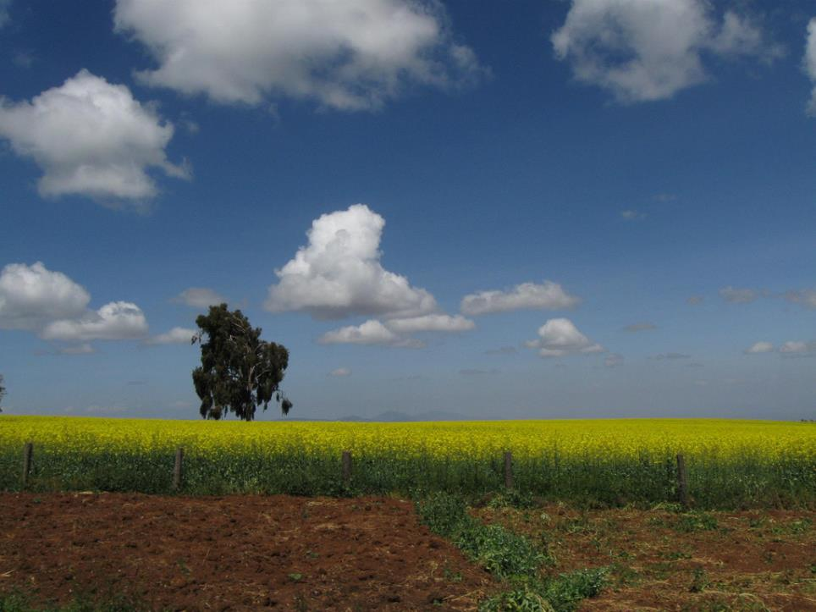
Countryside Farmland
Notes:
Kenya_countryside_farm
http://www.flickr.com/photos/aiace/3213036047/in/set-72157612498560932/

Slide 14
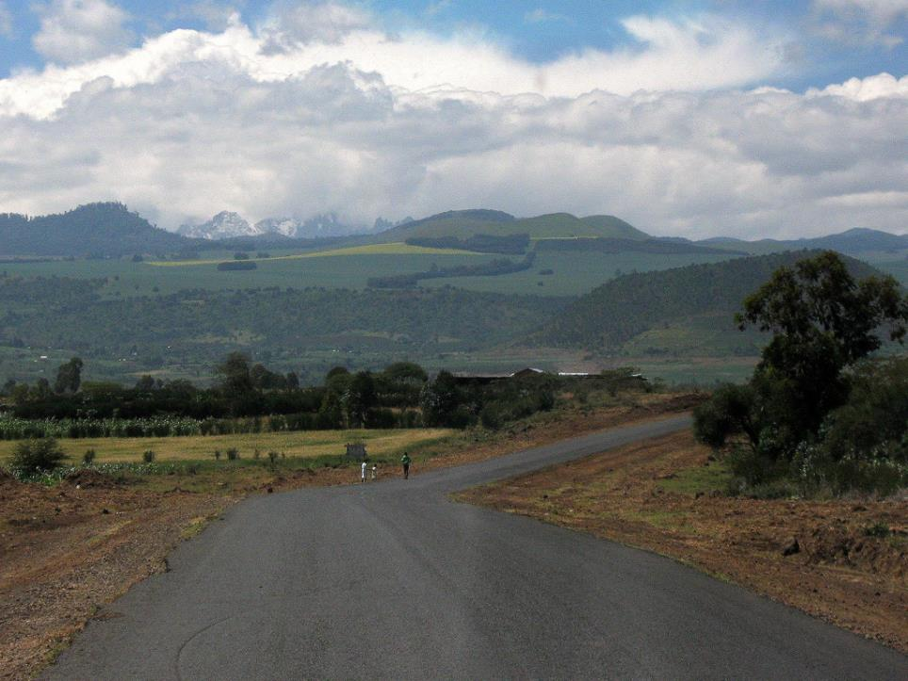
Notes:
Kenya_countryside_road
http://www.flickr.com/photos/aiace/3213881616/in/set-72157612498560932/

Slide 15
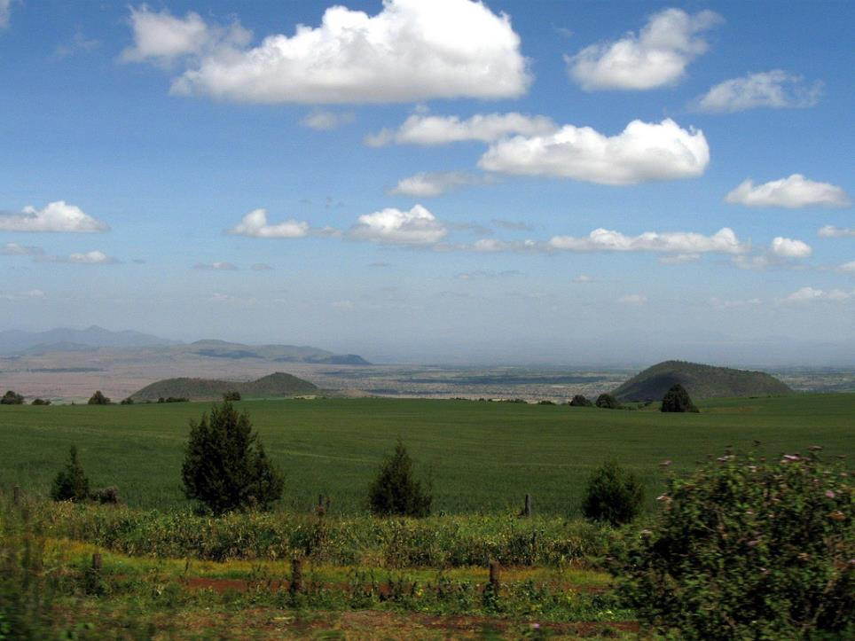
Notes:
Kenya_countryside_hills
http://www.flickr.com/photos/aiace/3213881972/in/set-72157612498560932/

Slide 16
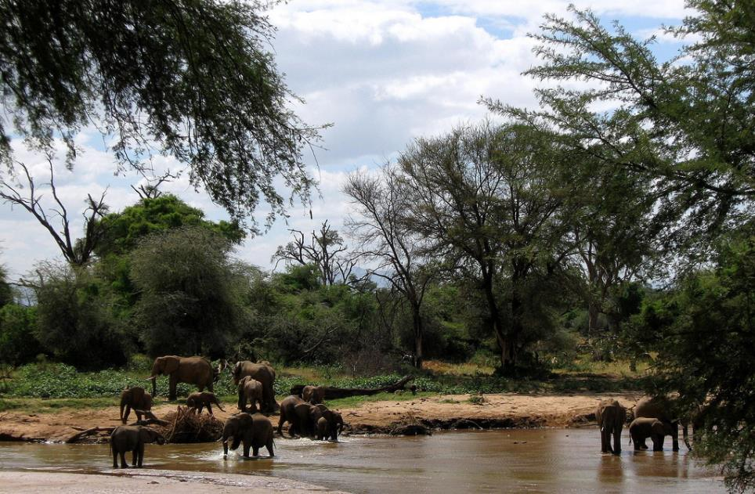
Notes:
Kenya_elephants_bath
http://www.flickr.com/photos/aiace/3213026545/in/set-72157612498560932/

Slide 17
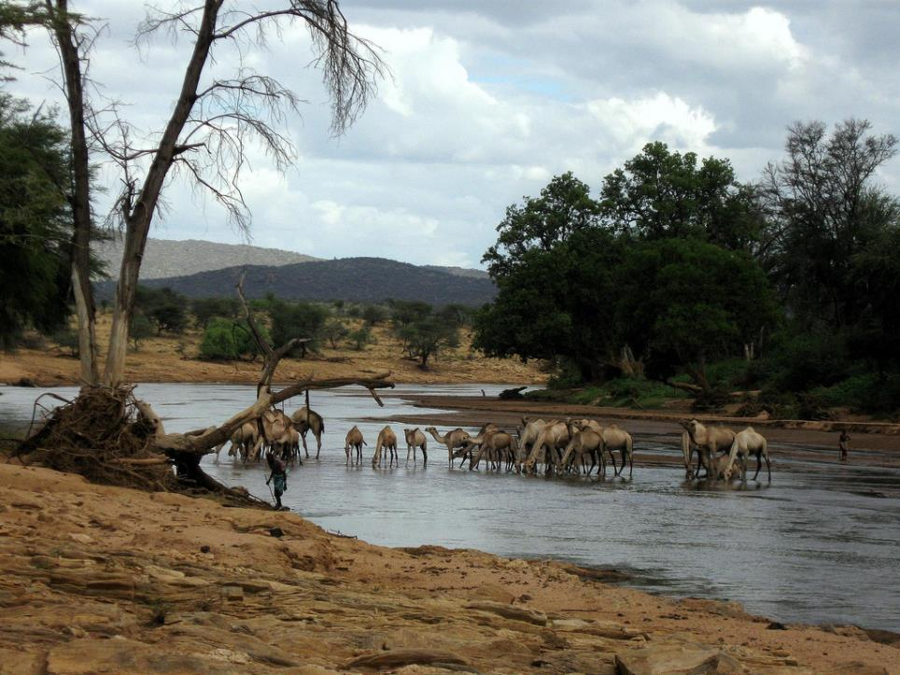
Notes:
Kenya_EwasoRiver_camels
http://www.flickr.com/photos/aiace/3213027119/in/set-72157612498560932/

Slide 18
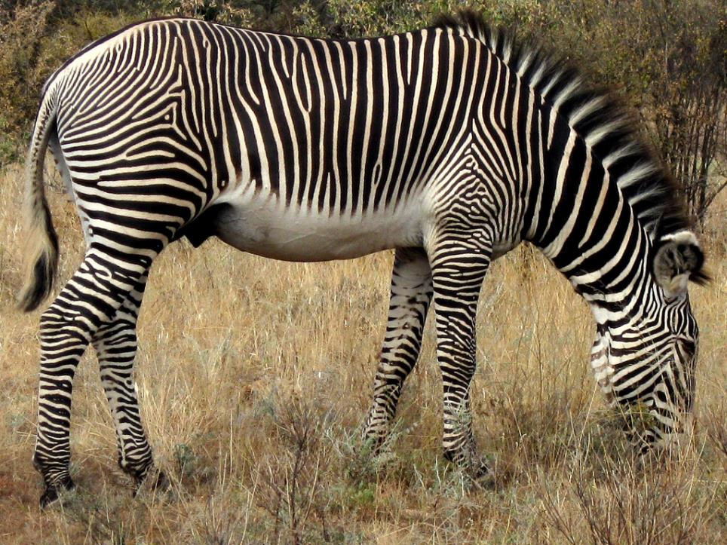
Notes:
Kenya_Greavy_zebra
http://www.flickr.com/photos/aiace/3213878124/in/set-72157612498560932/

Slide 19
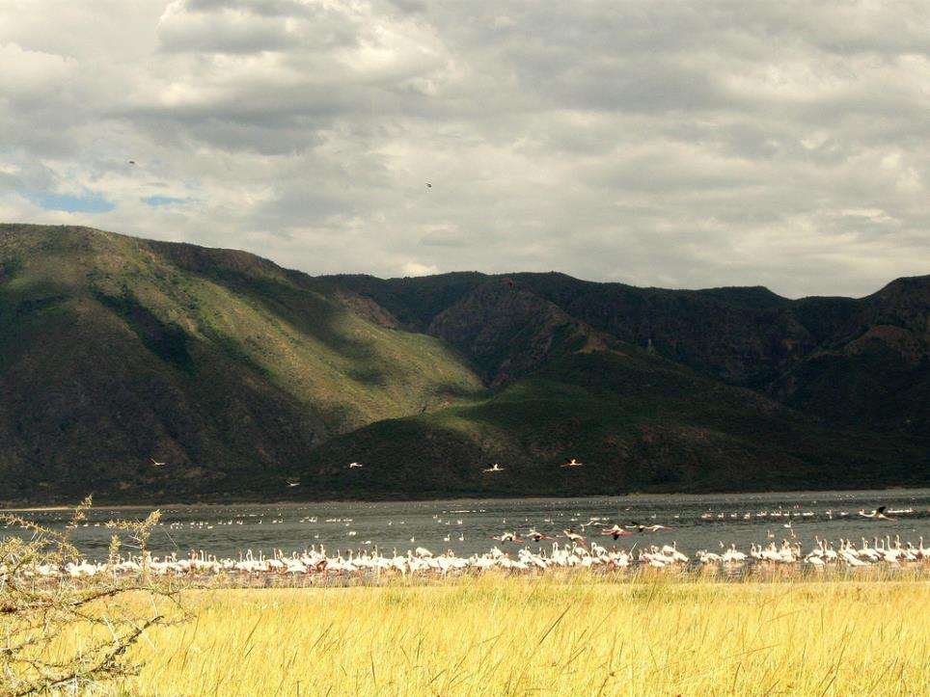
Lake Bogoria
Notes:
Kenya_Lake_ Bogoria
http://www.flickr.com/photos/aiace/3213094393/in/set-72157612498560932/

Slide 20
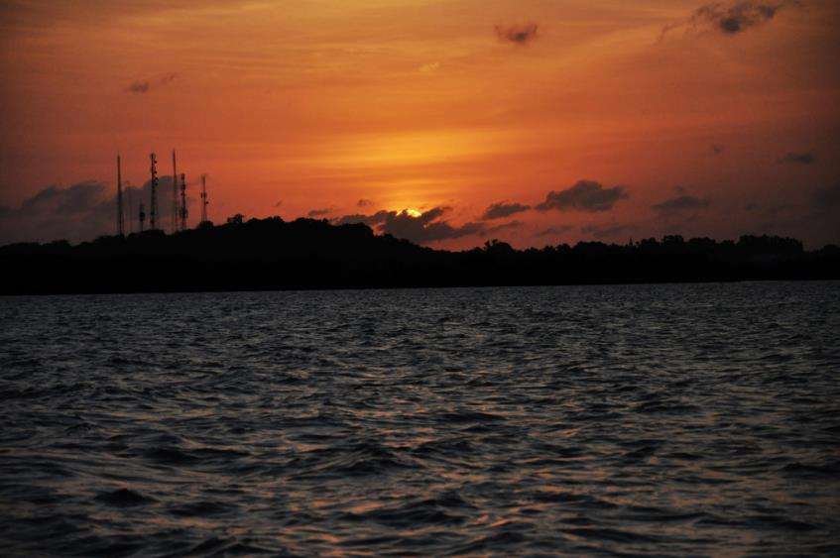
Notes:
Kenya_Lamu_sunset
http://www.flickr.com/photos/neilward/5105287220/in/faves-30556726@N04/

Slide 21
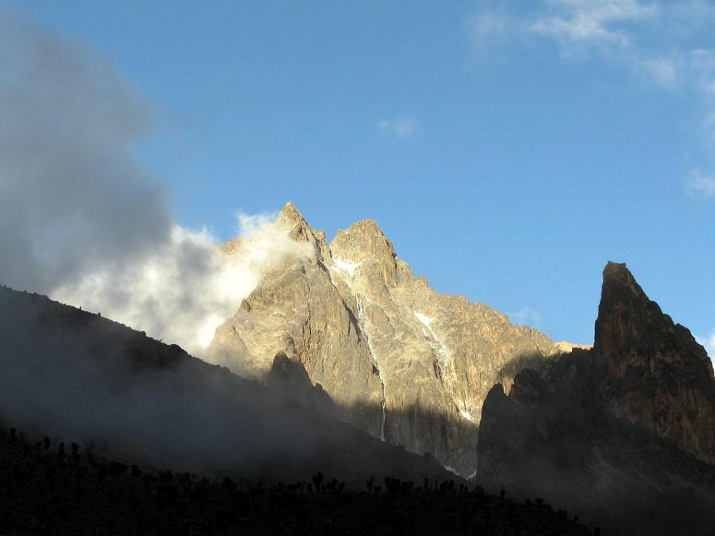
Notes:
Kenya_Mount_Kenya
http://www.flickr.com/photos/aiace/3211250912/in/set-72157612498560932/

Slide 22
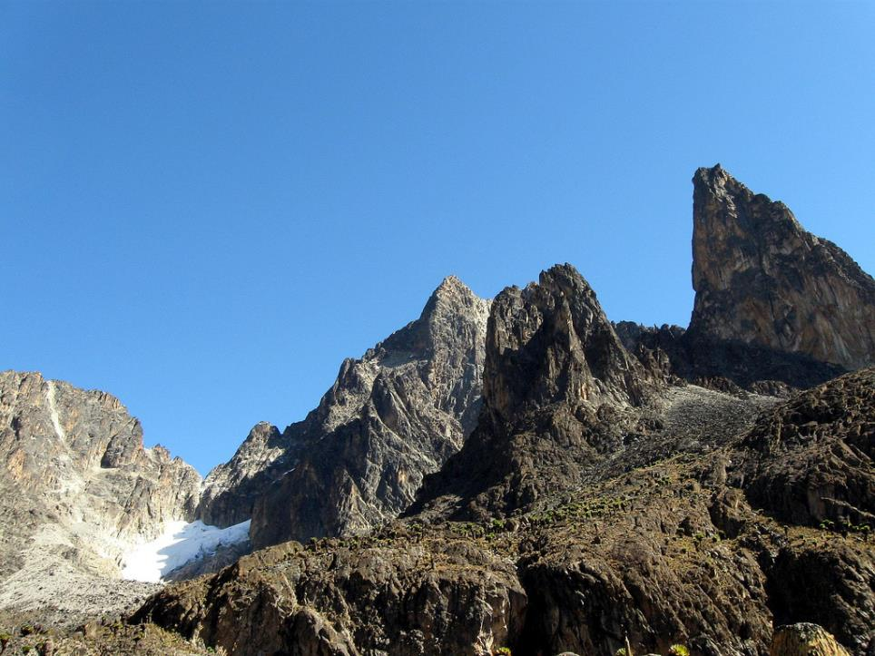
Notes:
Kenya_Mount_Kenya_ Batian_Point_SaintJohn
http://www.flickr.com/photos/aiace/3210407457/in/set-72157612498560932/
Batian and Point Saint John

Slide 23
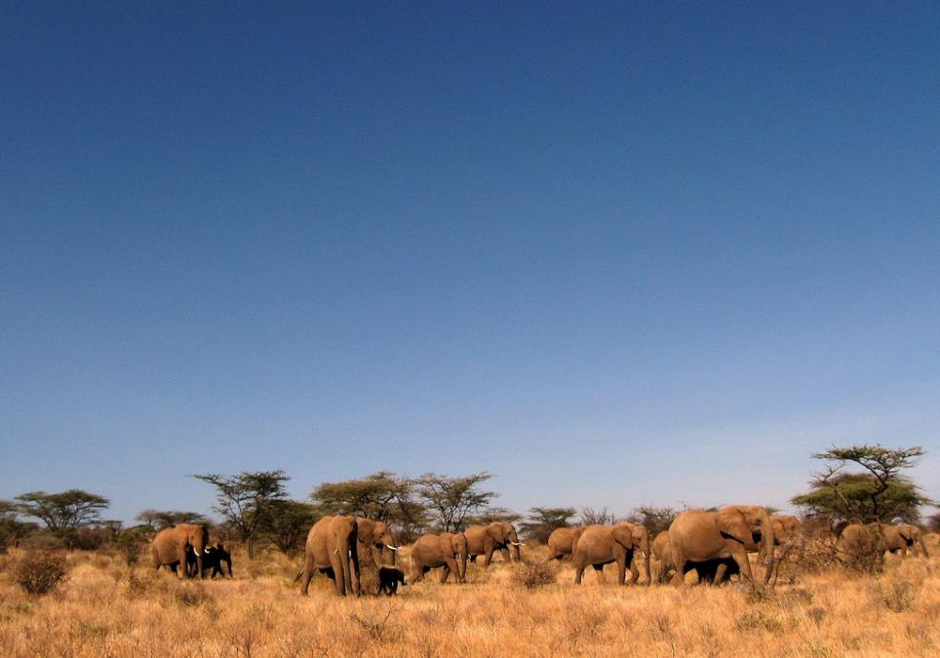
Sambura Elephants
Notes:
Kenya_Sambura_elephants
http://www.flickr.com/photos/aiace/3213875314/in/set-72157612498560932/

Slide 24
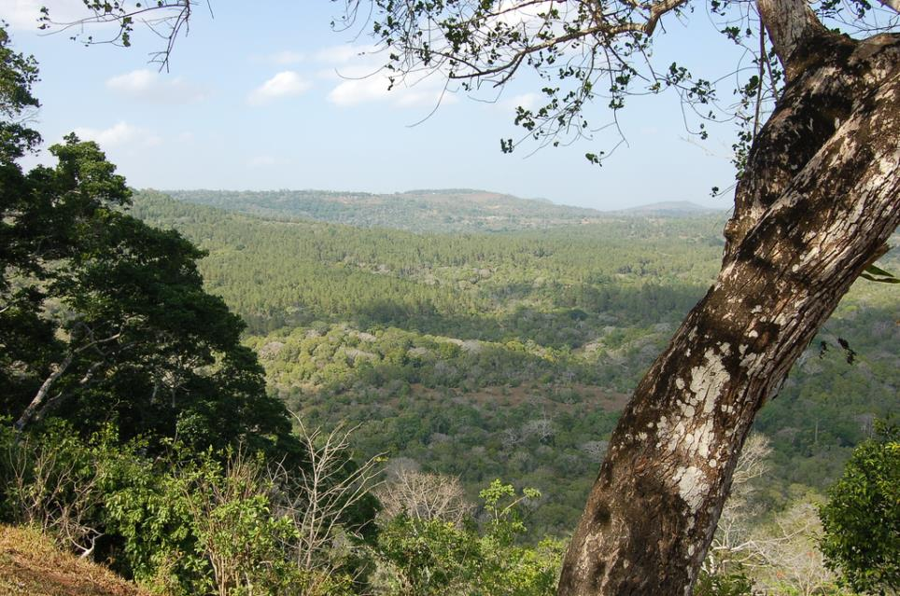
Notes:
Kenya_Simba_Hills
http://www.flickr.com/photos/mattandkim/94882059/in/faves-30556726@N04/

Slide 25
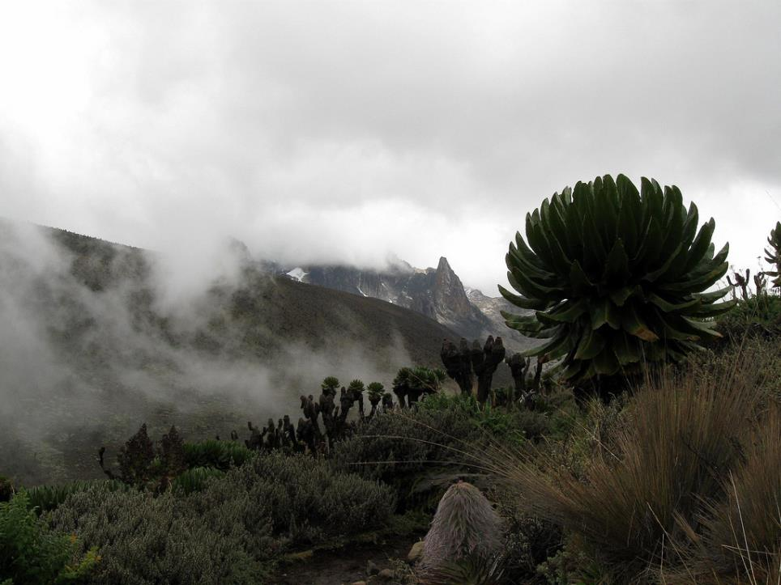
Teleki Valley
Notes:
Kenya_teleki valley
http://www.flickr.com/photos/aiace/3211250666/in/set-72157612498560932/

Slide 26
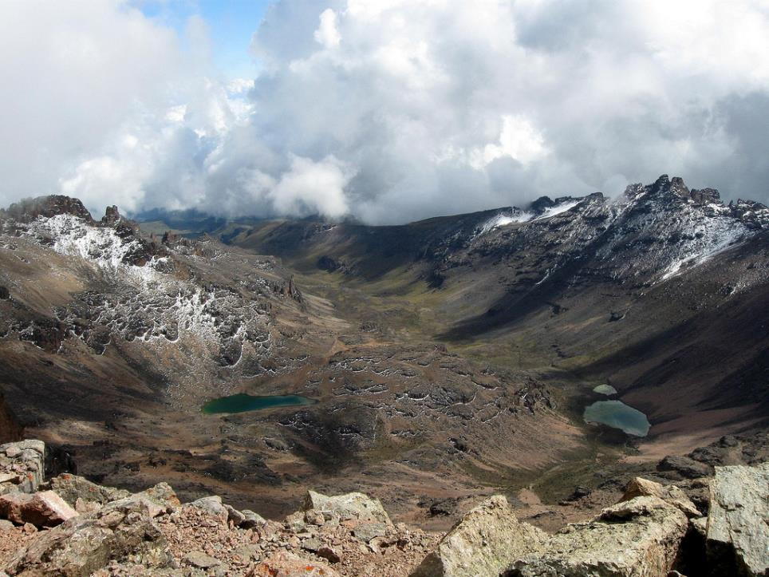
Mount Kenya
Notes:
Kenya_Mount_Kenya_ from_point_Lenana
http://www.flickr.com/photos/aiace/3211255670/in/set-72157612498560932/

Slide 27
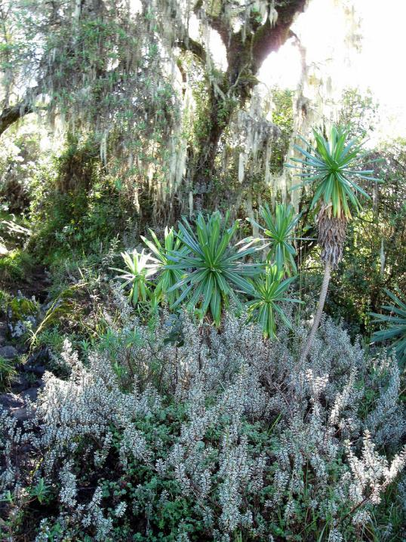
Notes:
Kenya_tropical_forest_1
http://www.flickr.com/photos/aiace/3210401337/in/set-72157612498560932/

Slide 28
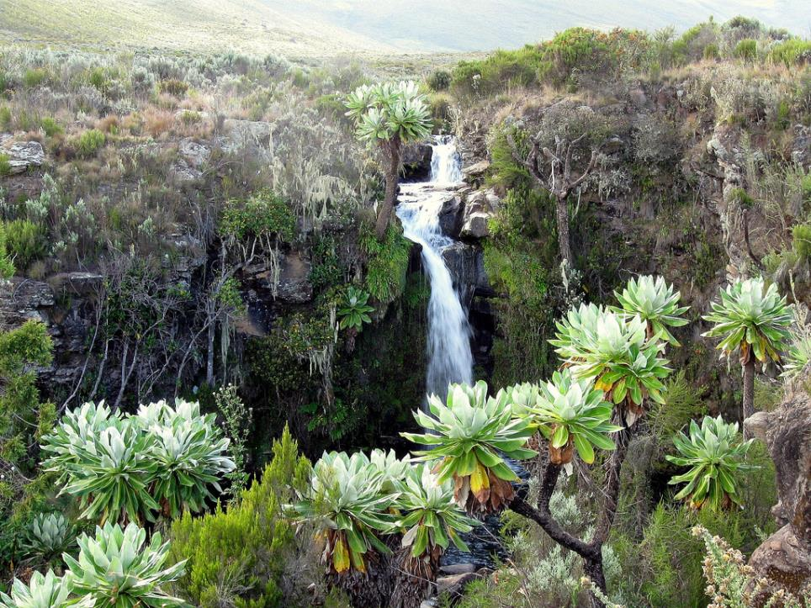
Waterfall in Chagoria
Notes:
Kenya_Waterfall_Chogoria
http://www.flickr.com/photos/aiace/3210431203/in/set-72157612498560932/

Slide 29
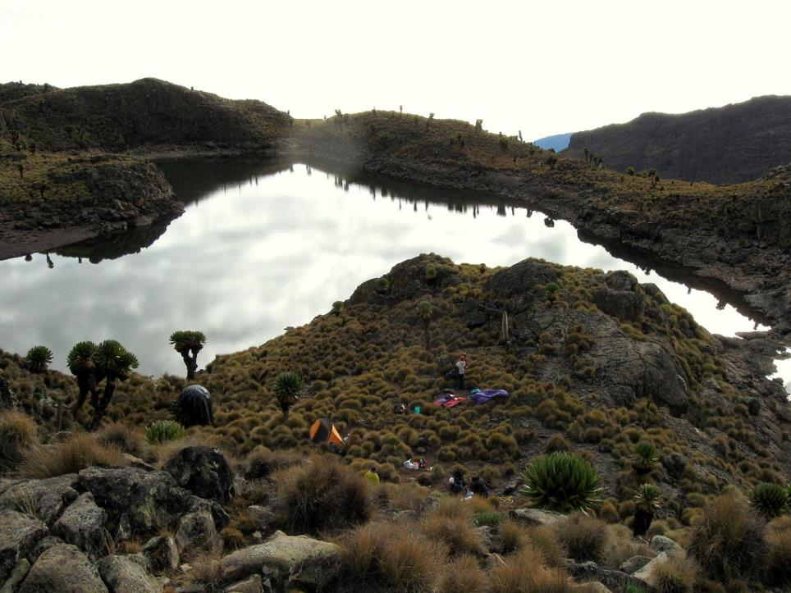
Notes:
Kenya_ Minto's_tarn
http://www.flickr.com/photos/aiace/3211268708/in/set-72157612498560932/

Slide 30
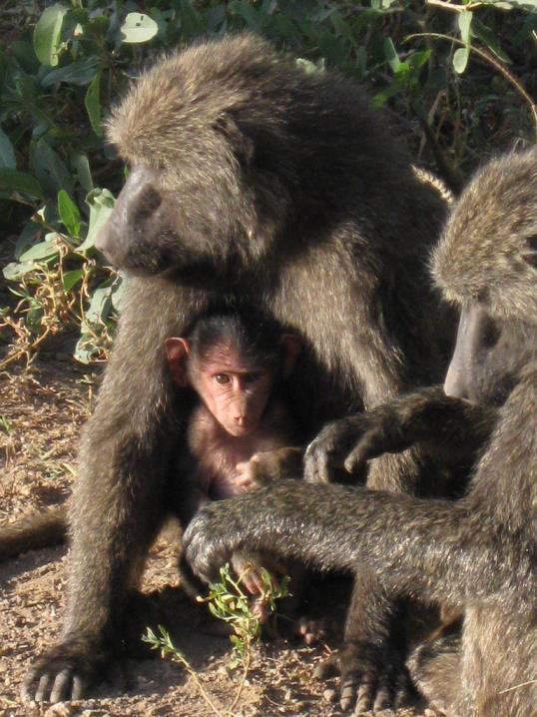
Baboon Family
Notes:
Kenya_babus_family
http://www.flickr.com/photos/aiace/3213028831/in/set-72157612498560932/

Slide 31
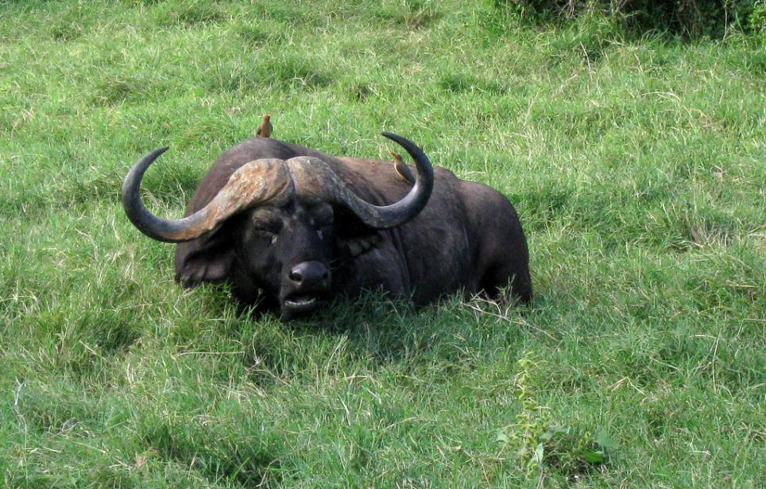
Buffalo
Notes:
Kenya_buffalo
http://www.flickr.com/photos/aiace/3213878996/in/set-72157612498560932/

Slide 32
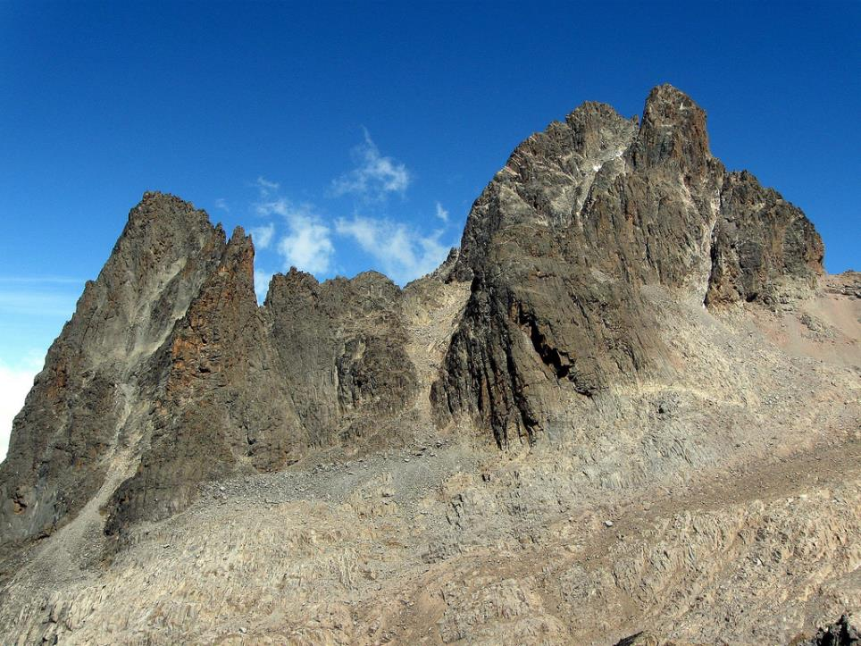
Mount Kenya Summits
Notes:
Kenya_Mount_Kenya_summits
http://www.flickr.com/photos/aiace/3211254078/in/set-72157612498560932/

Slide 33
Man-made features
Young Geographers Travel to Kenya

Slide 34
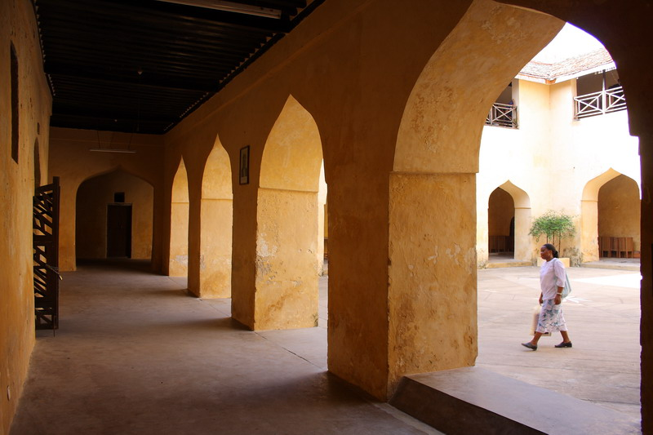
Notes:
Kenya_Lamu_courtyard
http://www.flickr.com/photos/cak2/4102216744/in/set-72157622798741842/

Slide 35
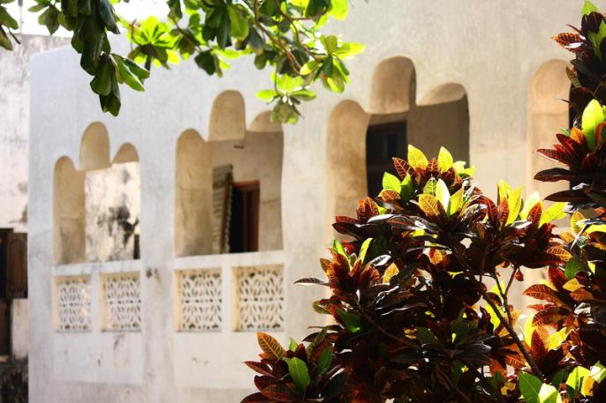
Notes:
Kenya_Lamu_building
http://www.flickr.com/photos/cak2/4102213878/in/set-72157622798741842/

Slide 36
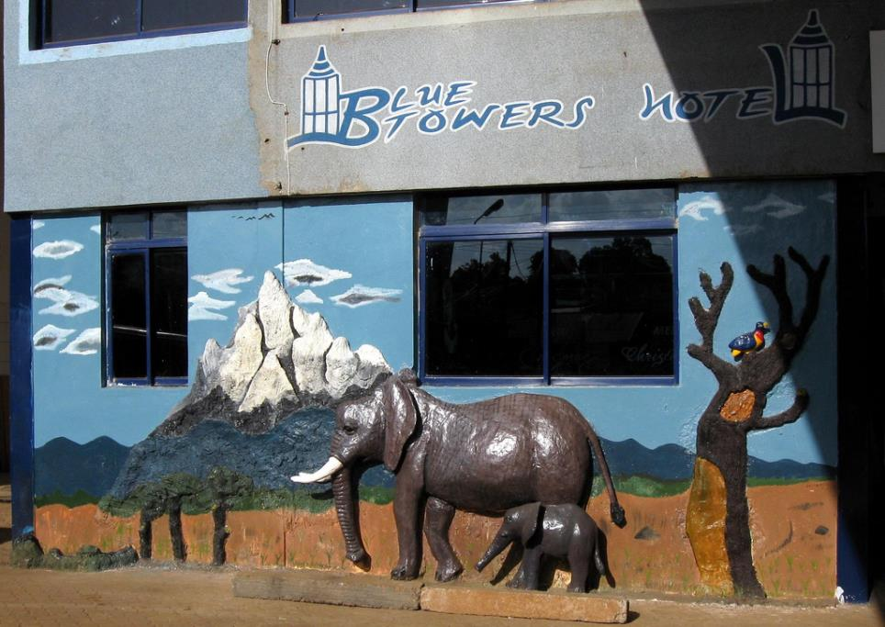
Notes:
Kenya_Meru_hotel
http://www.flickr.com/photos/aiace/3213868688/in/set-72157612498560932/

Slide 37
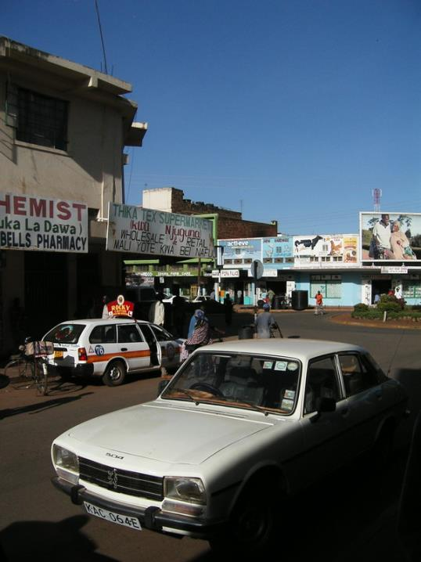
Notes:
Kenya_Thika_street
http://www.flickr.com/photos/cak2/418865570/in/set-72157604124248793/

Slide 38
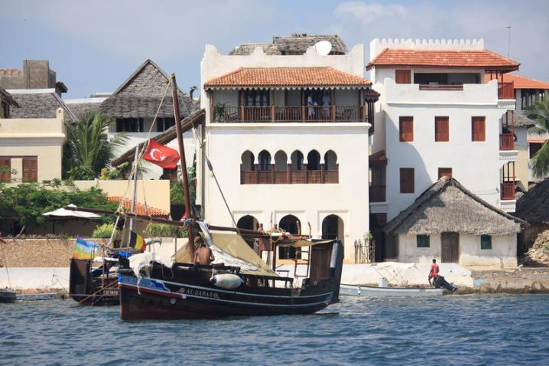
Notes:
Kenya_Lamu_harbor
http://www.flickr.com/photos/cak2/4102209276/in/set-72157622798741842/

Slide 39
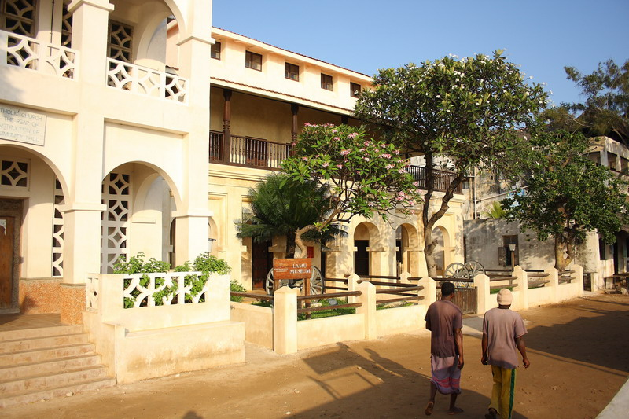
Notes:
Kenya_Lamu_museum
http://www.flickr.com/photos/cak2/4104002972/in/set-72157622798741842/

Slide 40
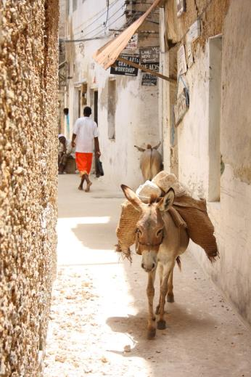
Notes:
Kenya_Lamu_road
http://www.flickr.com/photos/cak2/4103995644/in/set-72157622798741842/

Slide 41
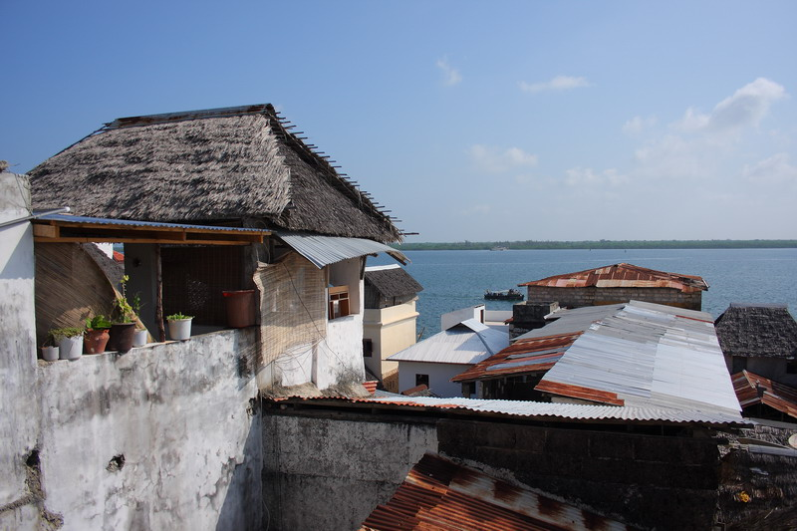
Notes:
Kenya_Lamu_rooftops
http://www.flickr.com/photos/cak2/4104014068/in/set-72157622798741842/

Slide 42
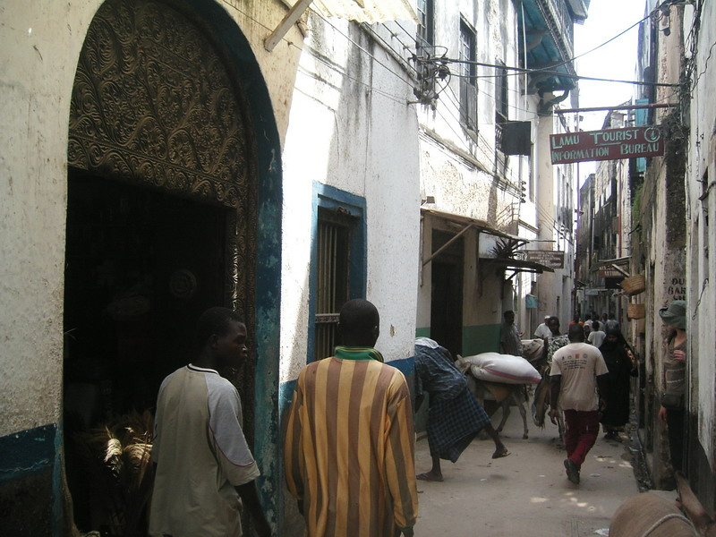
Notes:
Kenya_Lamu_street
http://www.flickr.com/photos/cak2/1061397055/in/set-72157604124248793/

Slide 43
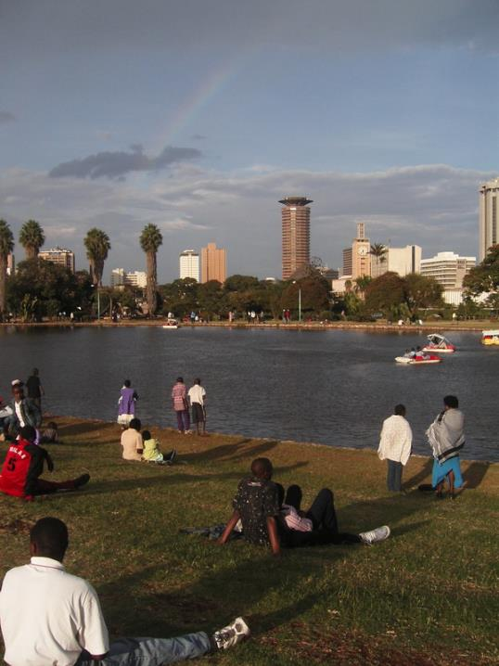
Notes:
Kenya_Nairobi_1
http://www.flickr.com/photos/cak2/2081439665/in/faves-30556726@N04/

Slide 44
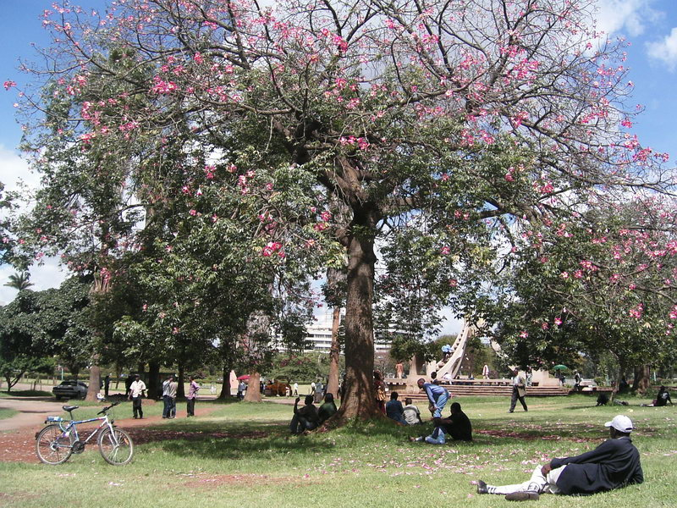
Notes:
Kenya_Nairobi_park
http://www.flickr.com/photos/cak2/481024587/in/set-72157604124248793/

Slide 45
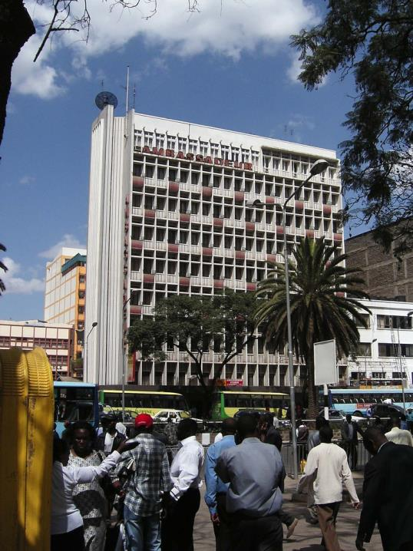
Notes:
Kenya_Nairobi_2
http://www.flickr.com/photos/cak2/431252447/in/set-72157604124248793/

Slide 46
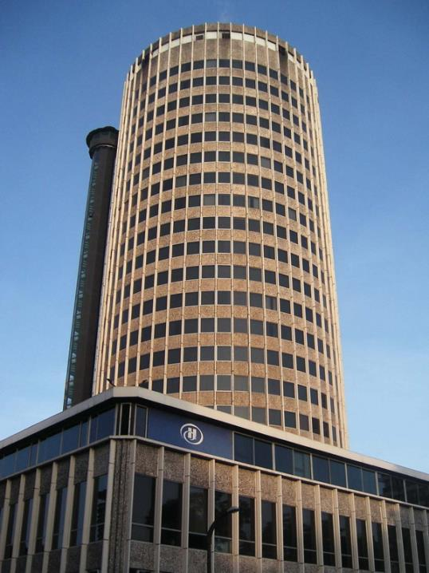
Notes:
Kenya_Nairobi_Hilton
http://www.flickr.com/photos/cak2/431252449/in/set-72157604124248793/

Slide 47
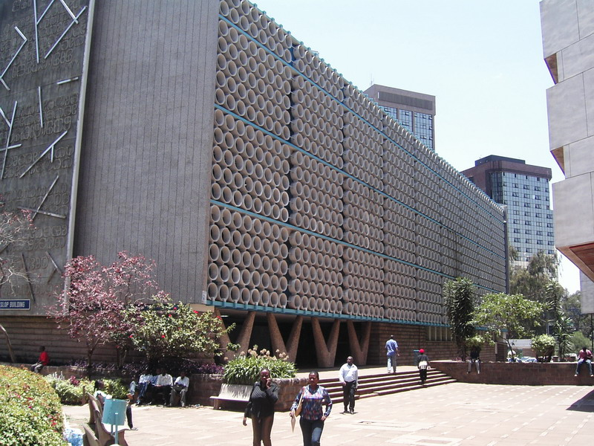
Notes:
Kenya_Nairobi_officebuildings
http://www.flickr.com/photos/cak2/431252444/in/set-72157604124248793/

