Slide 1
Safety and You
August 29, 2018
Peter Park, Team Leader

Slide 2
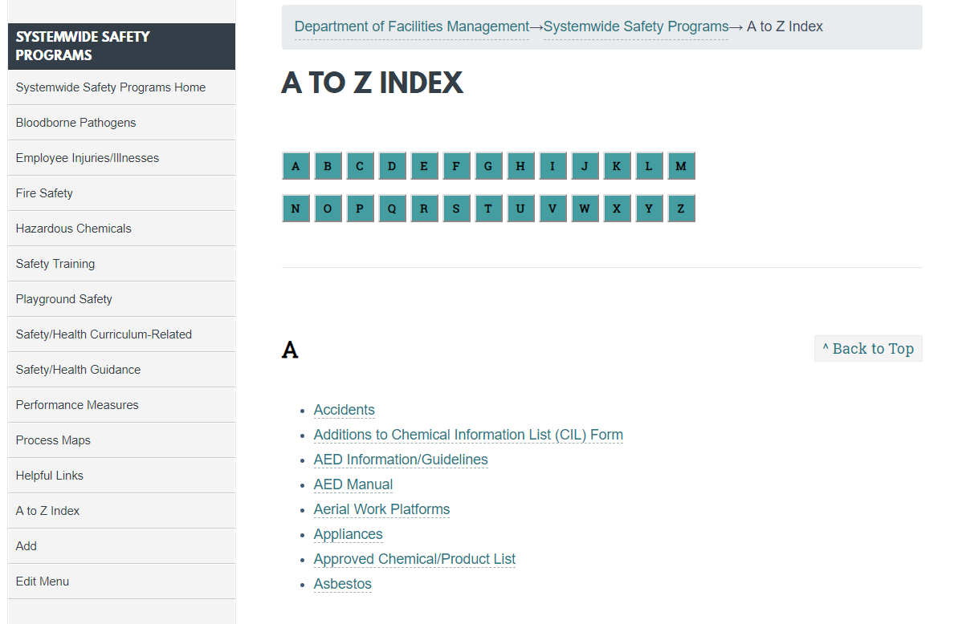
Website
www.montgomeryschoolsmd.org/departments/facilities/safety/

Slide 3
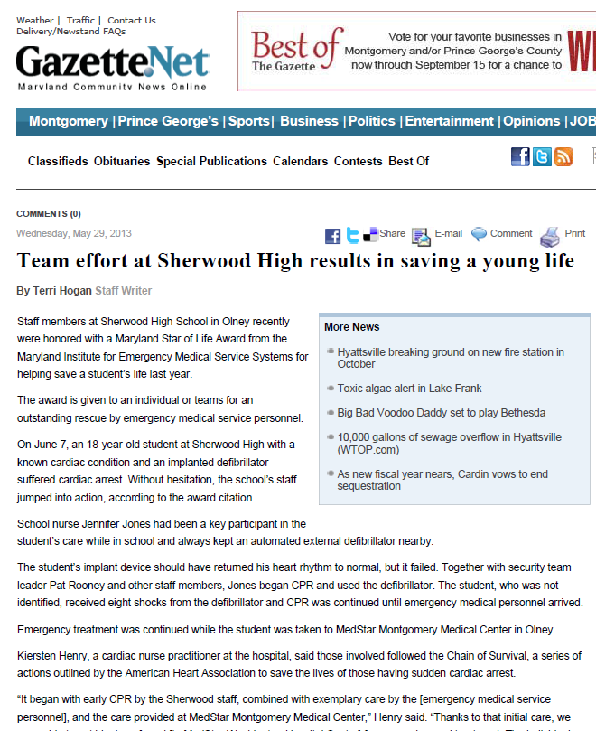
AEDs
Two Saves since 2006:
Dec. 14, 2008: BCCHS community member
June 7, 2012: Sherwood HS student

Slide 4
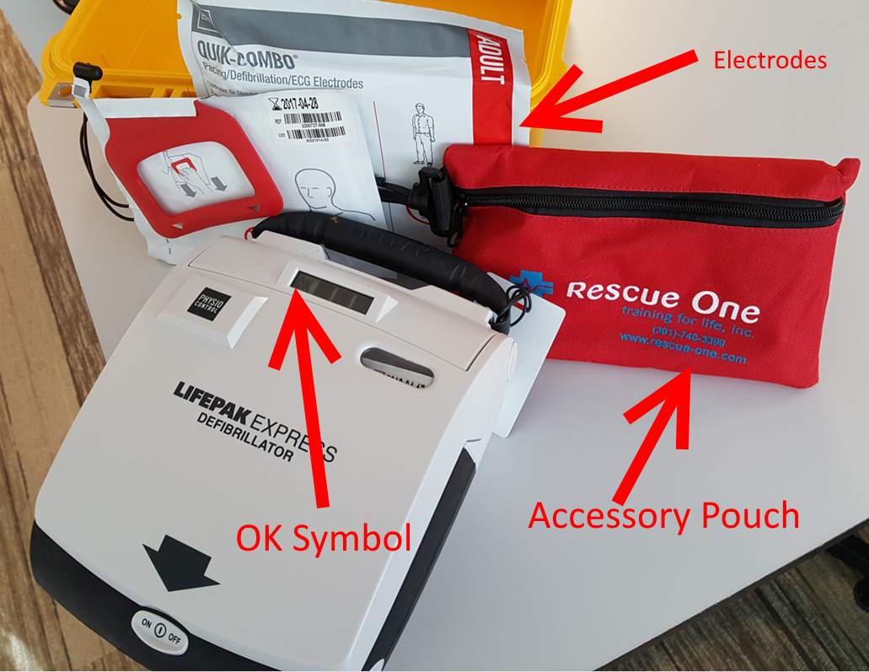
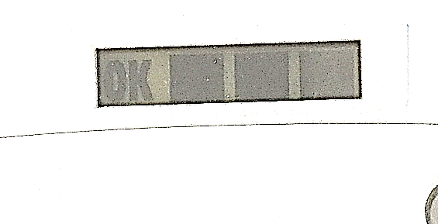
AEDs
Monthly Inspection

Slide 5
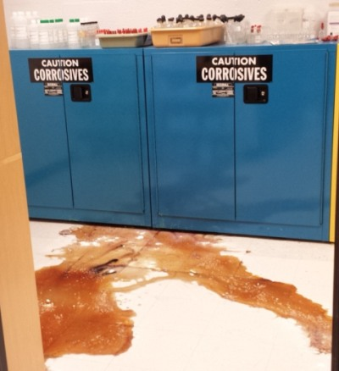
Hazardous Chemicals

Slide 6
Hazardous Chemicals

Slide 7
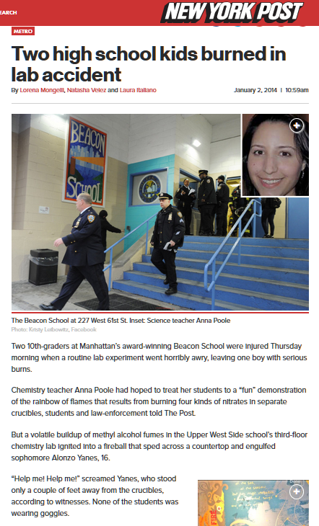
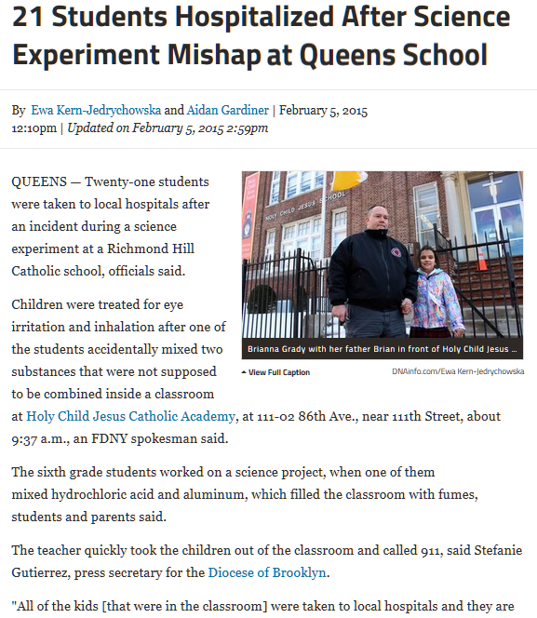
Hazardous Chemicals

Slide 8
Hazardous Chemicals

Slide 9
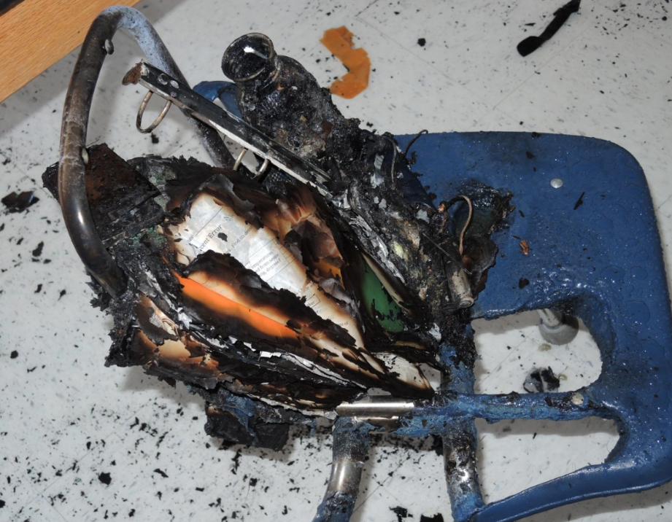
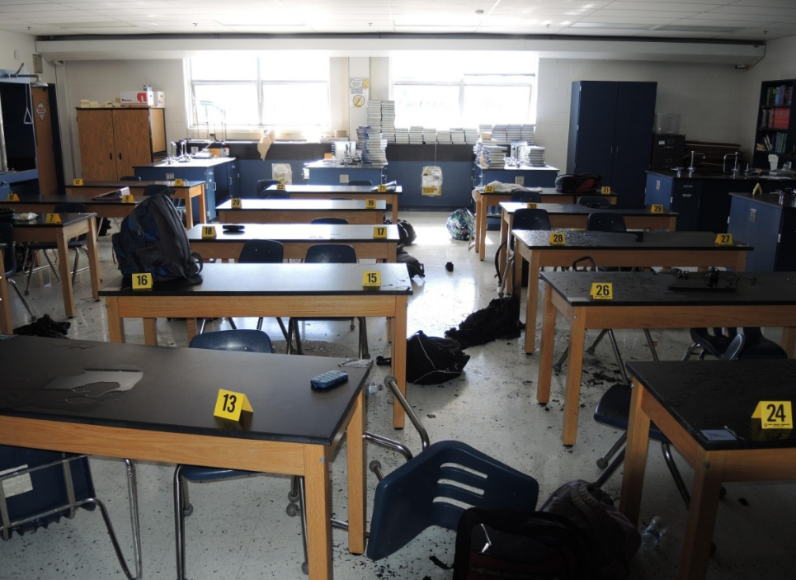
Hazardous Chemicals

Slide 10
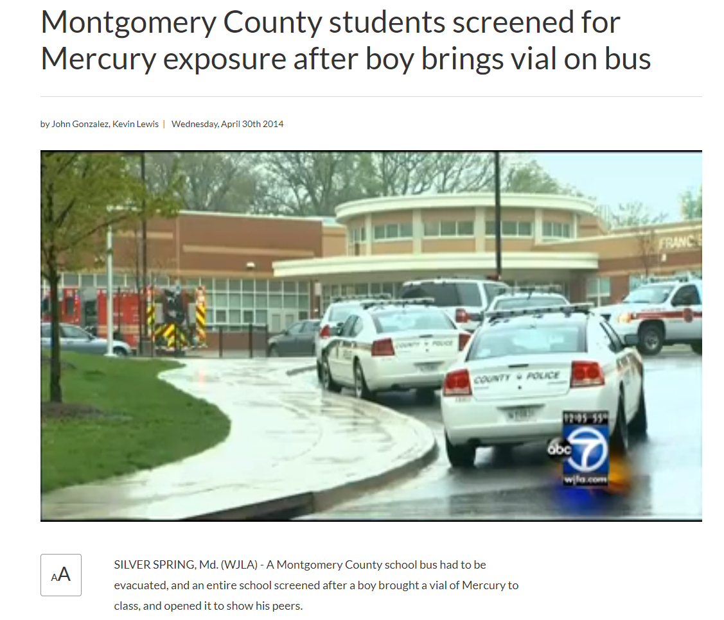
Hazardous Chemicals

Slide 11
Hazardous Chemicals What if you have a large chemical (or any mercury) spill?
DO NOT TRY TO CLEAN THE SPILL!
Evacuate, isolate the room or immediate area and open windows and turn off HVAC if can be done safely (Shelter in Place, if needed)
Call 911 if immediate help is needed or there are injuries
Sequester potentially contaminated materials and occupants in nearby hall or room, if possible
Provide first aid, as needed
Contact SSP (240-314-1070; 301-370-2141) or Maintenance (240-740-2500)

Slide 12
Hazardous Chemicals

Slide 13
Hazardous Chemicals

Slide 14
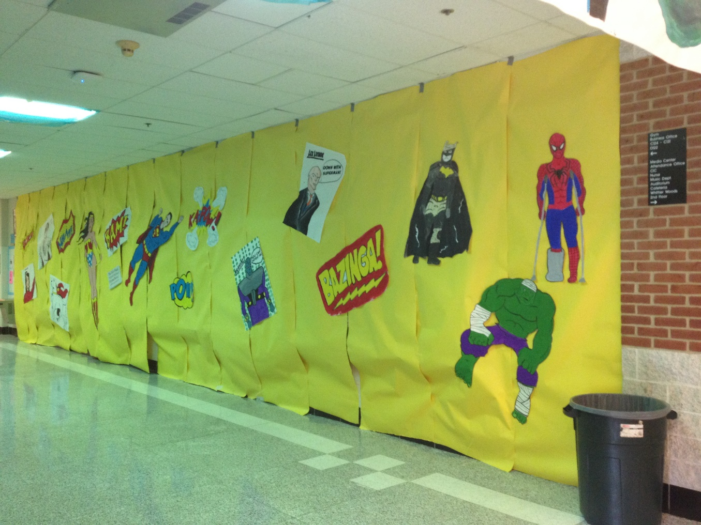
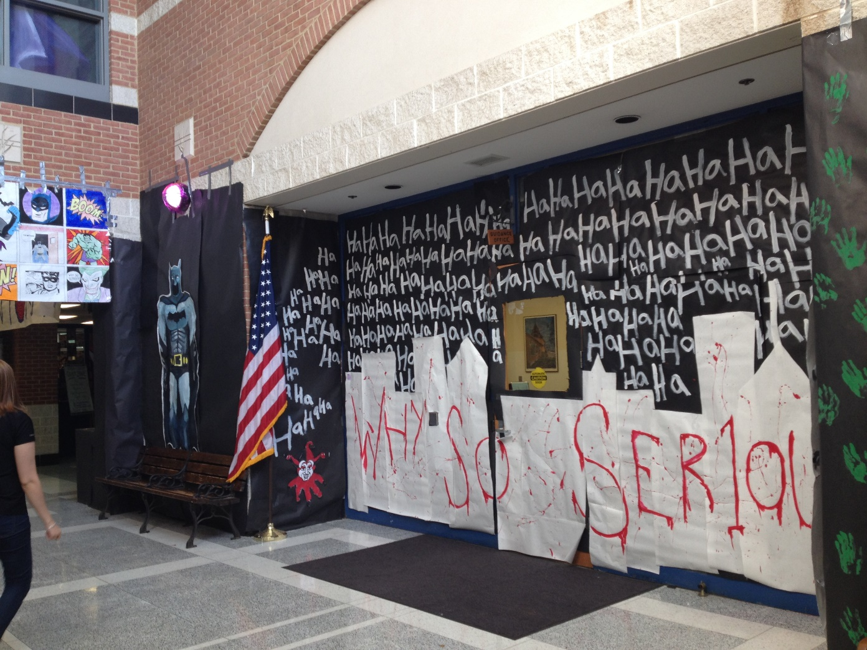
Fire Hazards

Slide 15
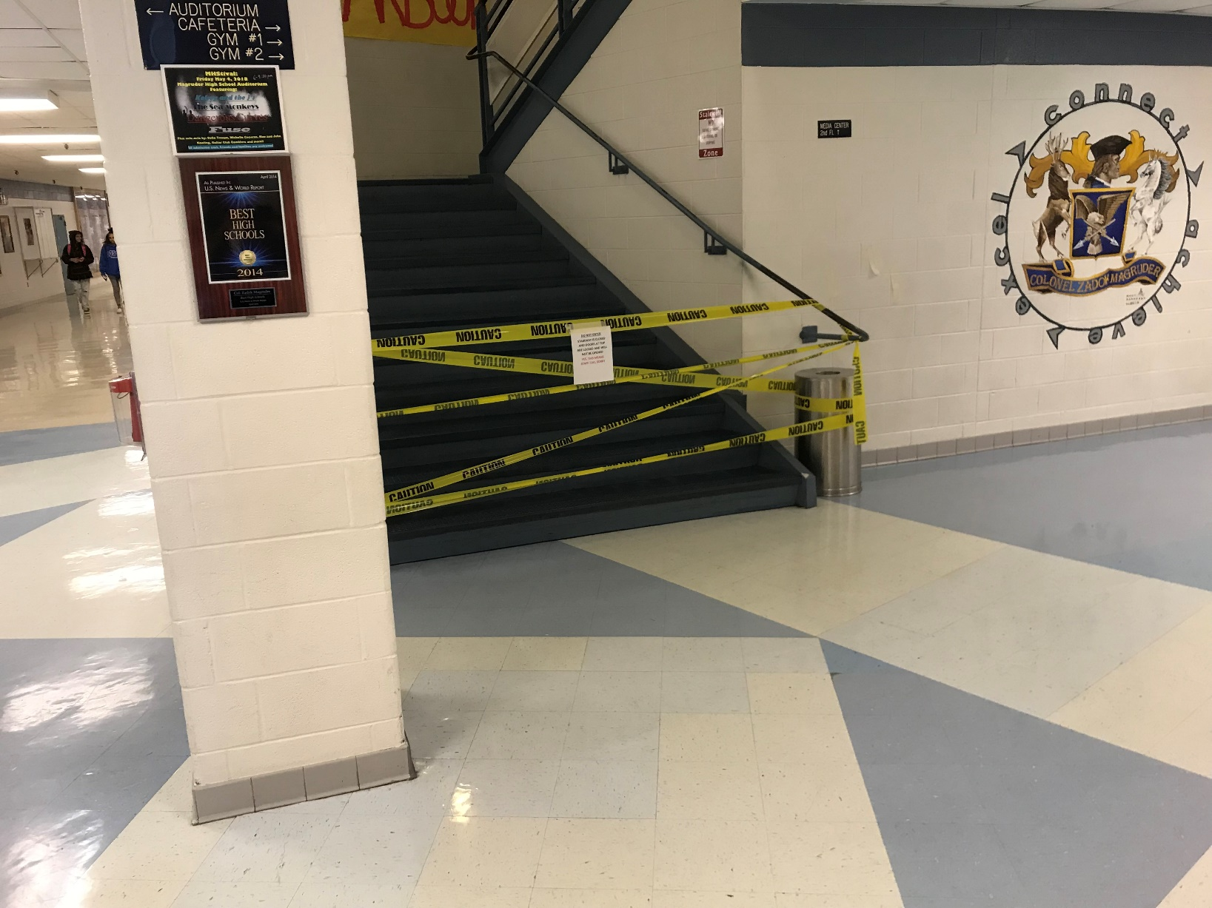
Fire Hazards

Slide 16
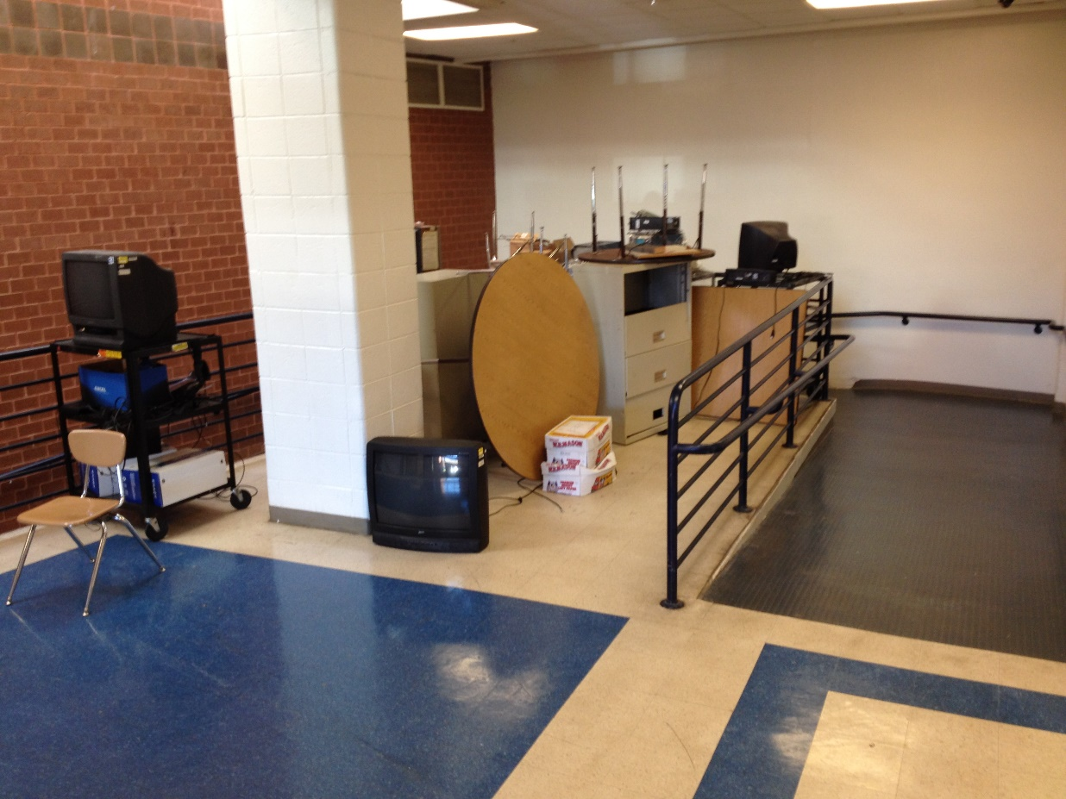
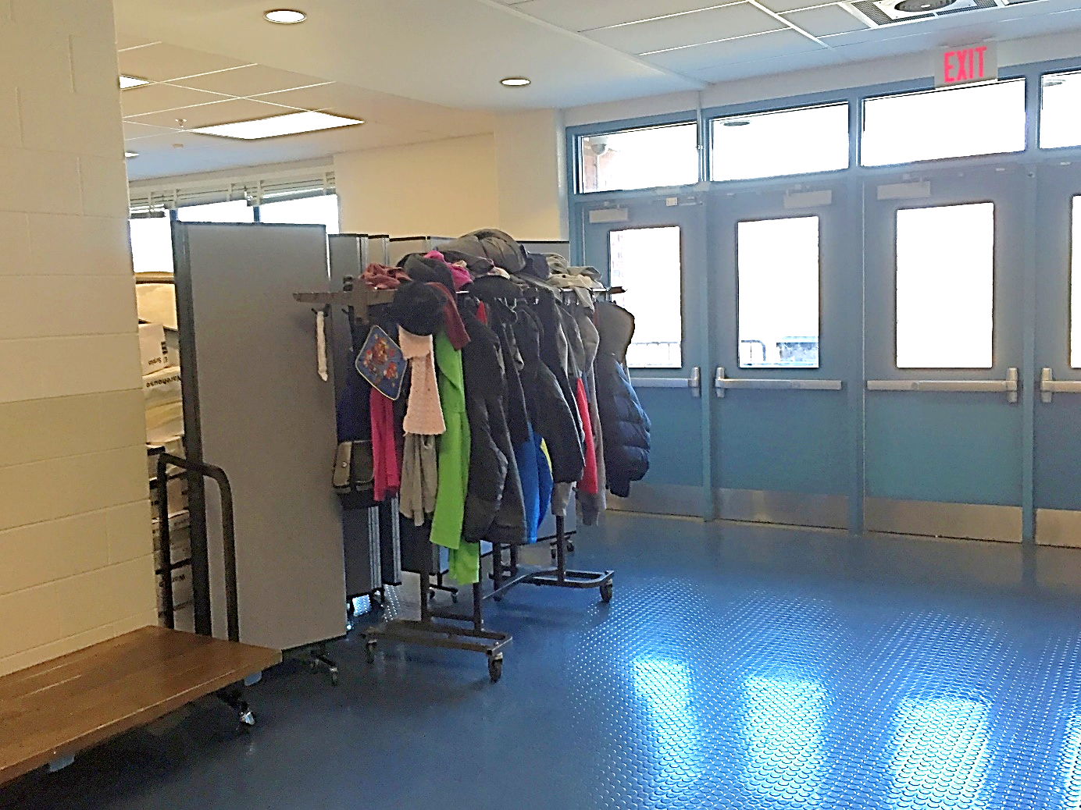
Fire Hazards
Look for this during fire drills*!
*Drills:
5/year; 2 during first 4 months (fully-sprinklered bldgs)
8/year; 3 during first 4 months

Slide 17
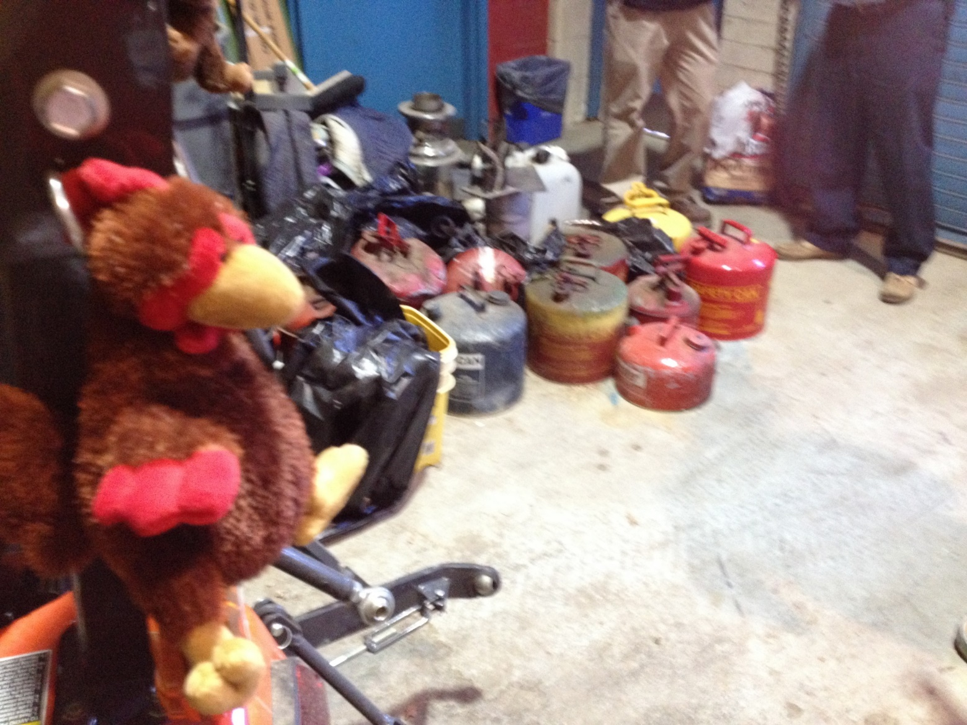
Fire Hazards

Slide 18
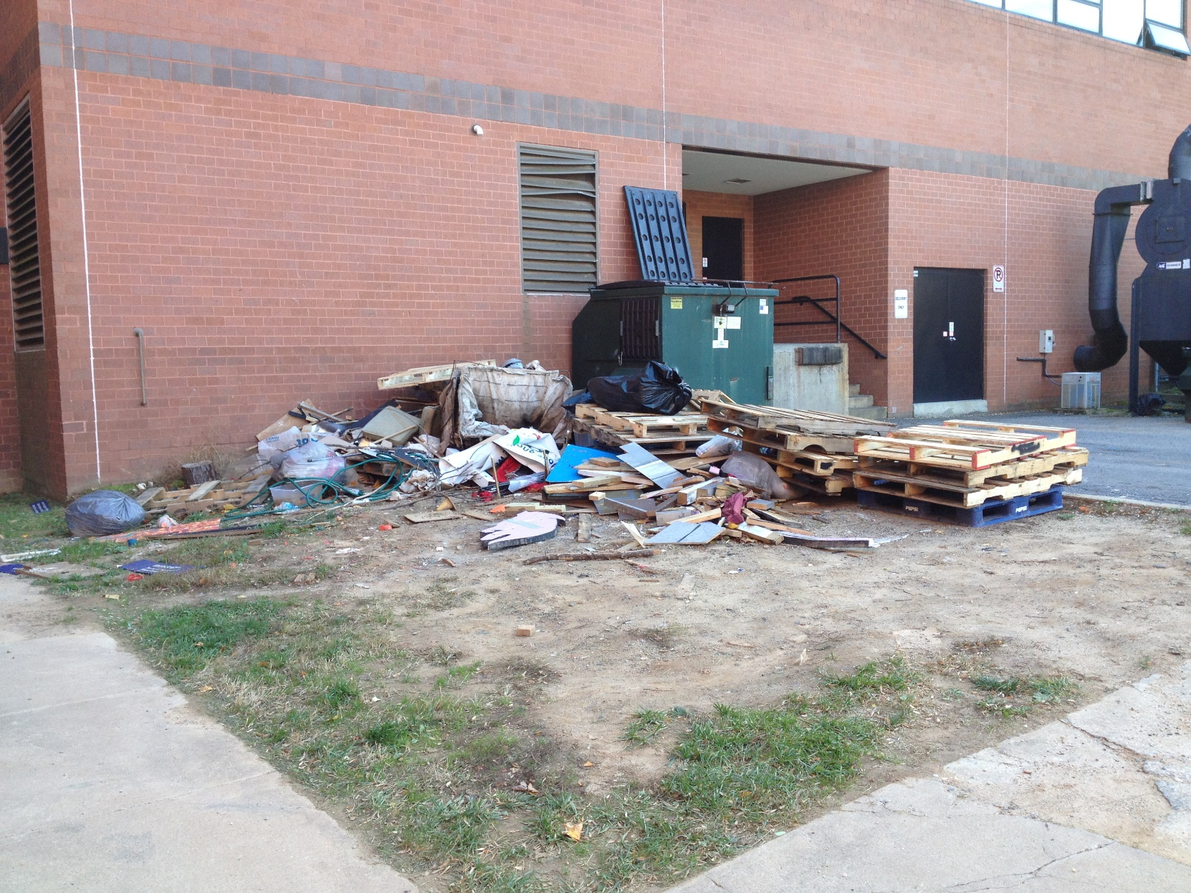
Fire Hazards

Slide 19
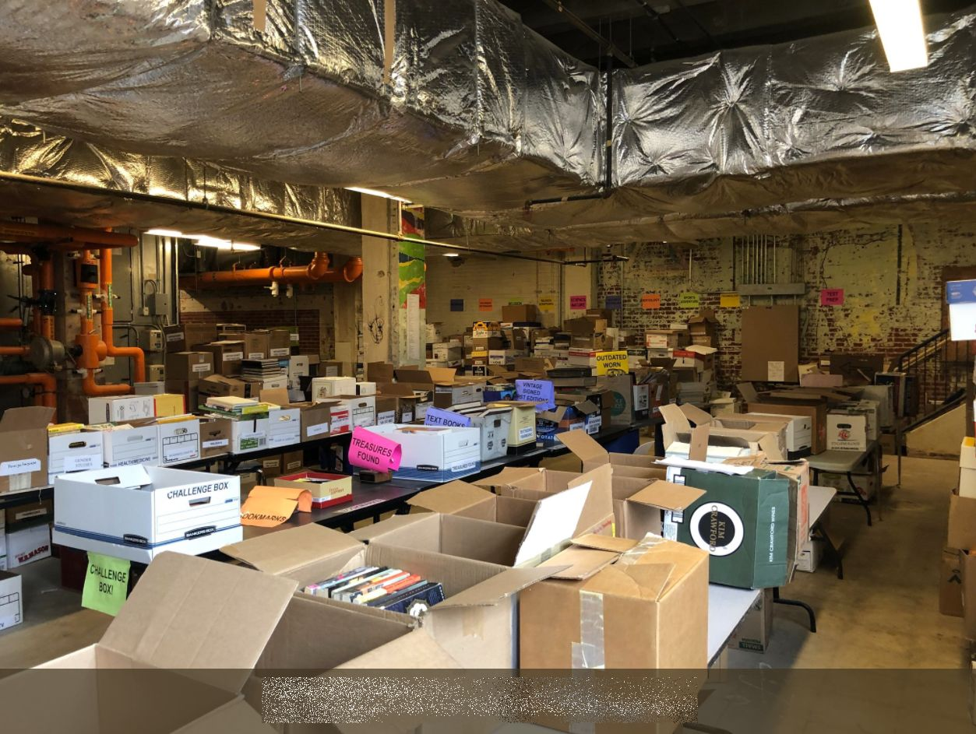
Fire Hazards

Slide 20
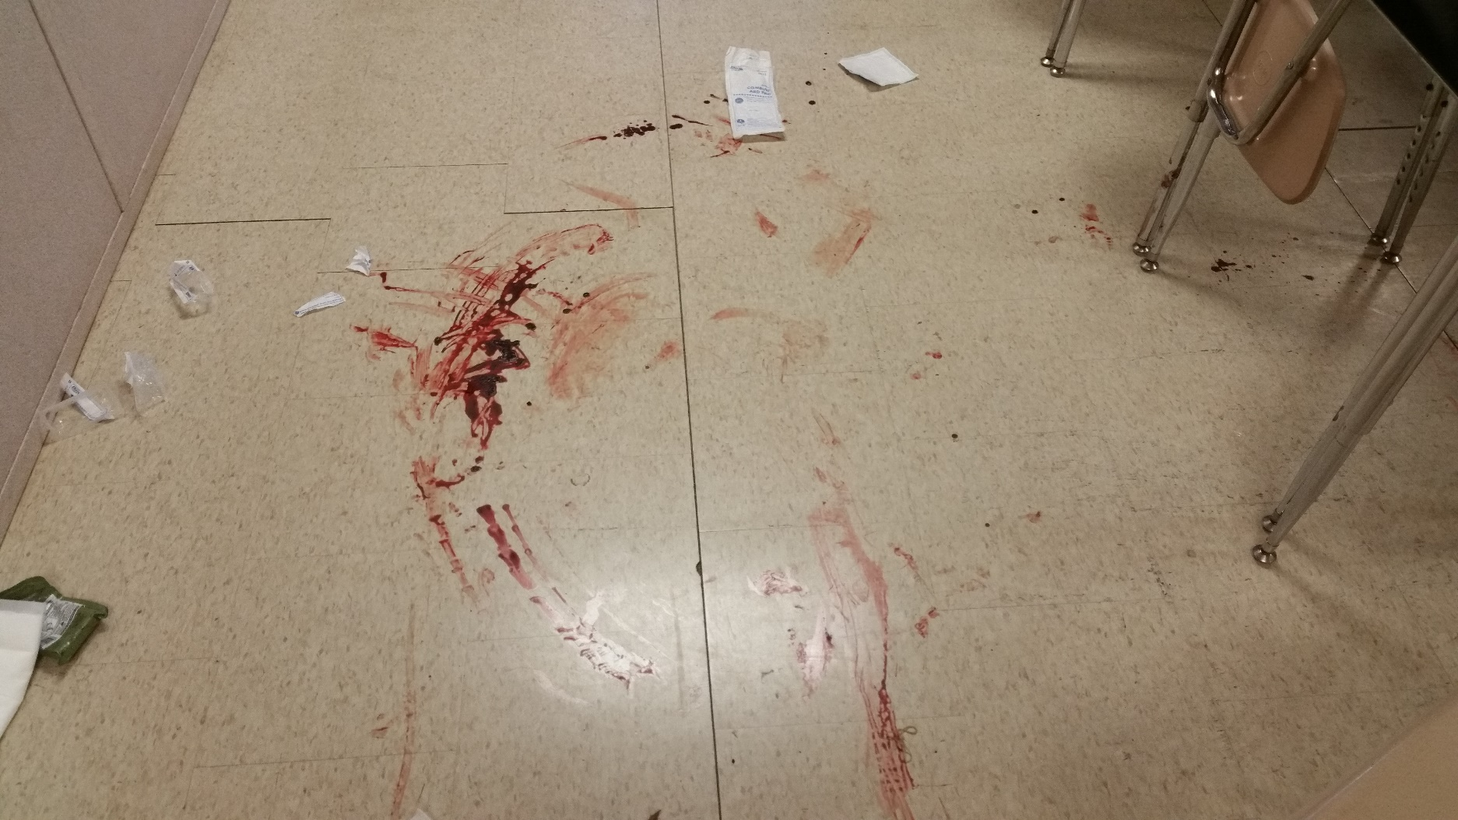
Bloodborne Pathogens

Slide 21
Bloodborne Pathogens
Disease-causing microorganisms in:
Human blood
Other Potentially Infectious Materials (OPIM):
Semen, vaginal secretions
Body fluids (cerebrospinal, synovial, pleural, pericardial, peritoneal)
Any body fluid visibly containing blood

Slide 22
Bloodborne Pathogens What do you do if you are exposed?
Notify supervisor – supervisor calls in ‘First Notice of Loss’ to CorVel 1-888-606-2562
Contact building services for clean-up using BBP kit
Contact MCPS-contracted clinic within 24 hours for evaluation
Required Forms:
Complete: 230-33, Bloodborne Pathogens Post-Exposure Report
Bring to clinic: 230-34, Health Care Professional’s Written Opinion Form
https://www.montgomeryschoolsmd.org/departments/facilities/safety/bloodborne.aspx#exposure

Slide 23
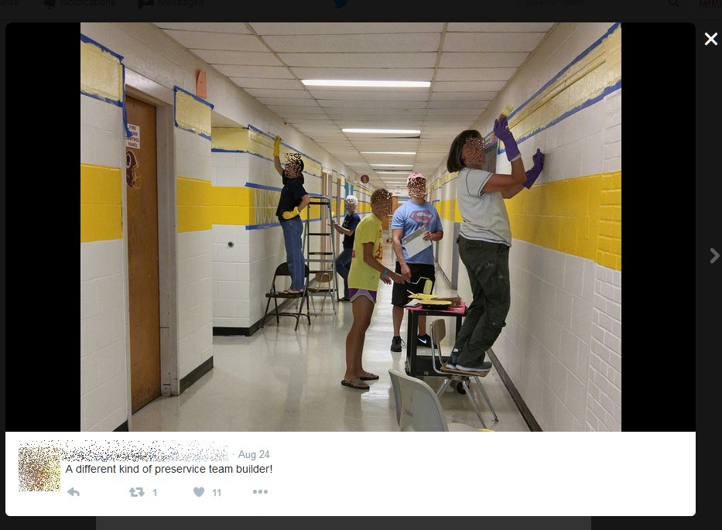
Fall Hazards

Slide 24
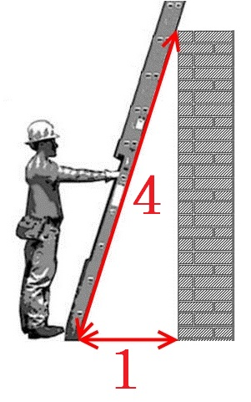
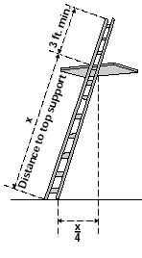
Fall Hazards
Place base at feet and hold the ladder with arms fully extended

Slide 25
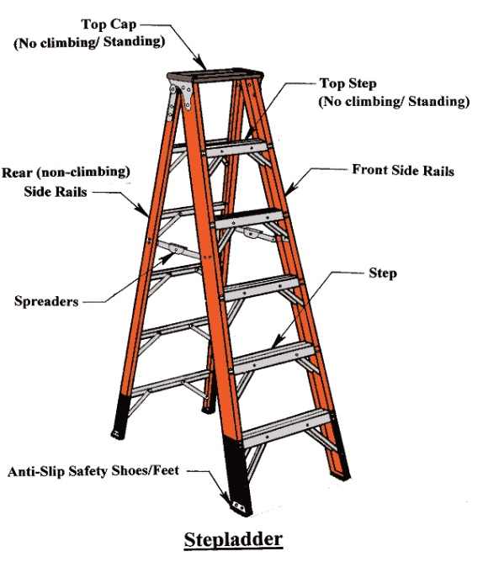
Fall Hazards

Slide 26
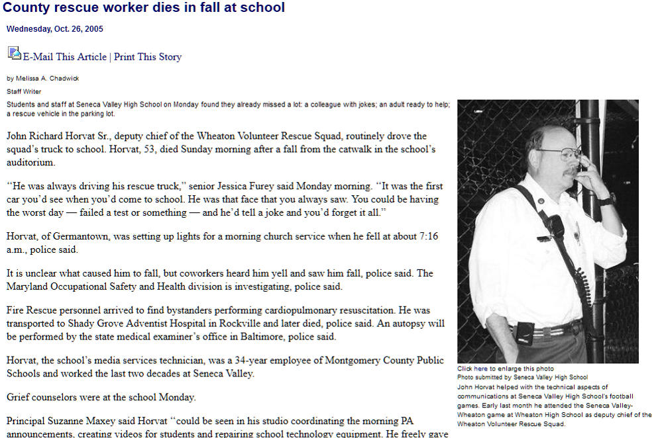
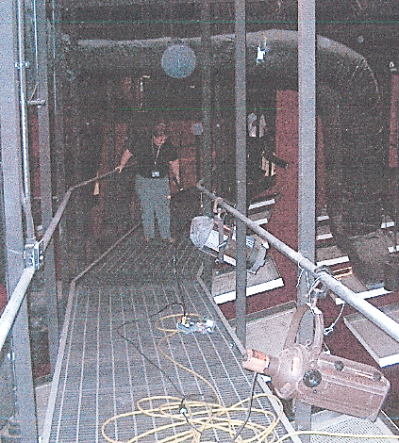
Fall Hazards

Slide 27
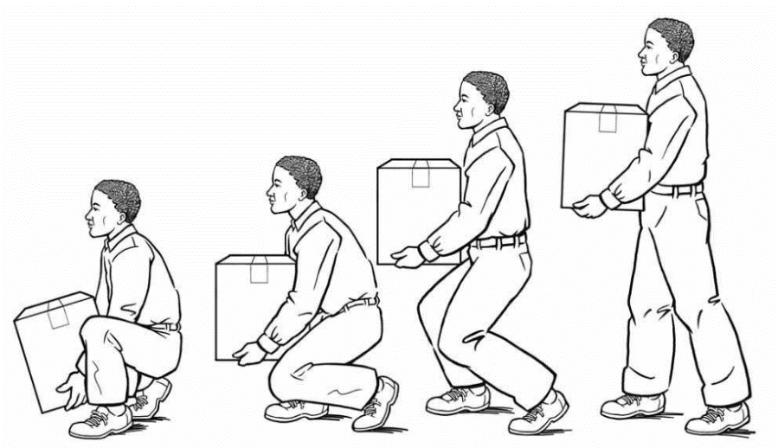
Ergonomic Hazards
If it’s too heavy or awkward, get help
Do not stretch or reach beyond the load
Keep your back straight; use your legs
Keep the load as close to your body as possible
Don’t twist or turn while carrying the load
Make sure your path is clear

Slide 28
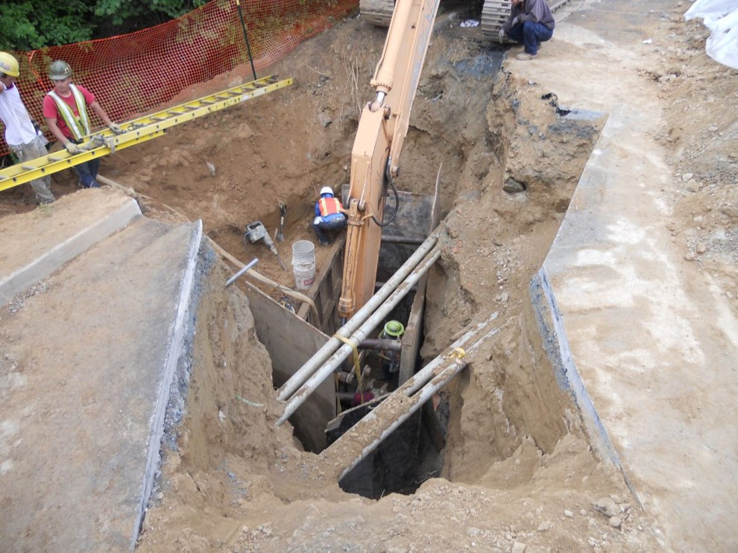
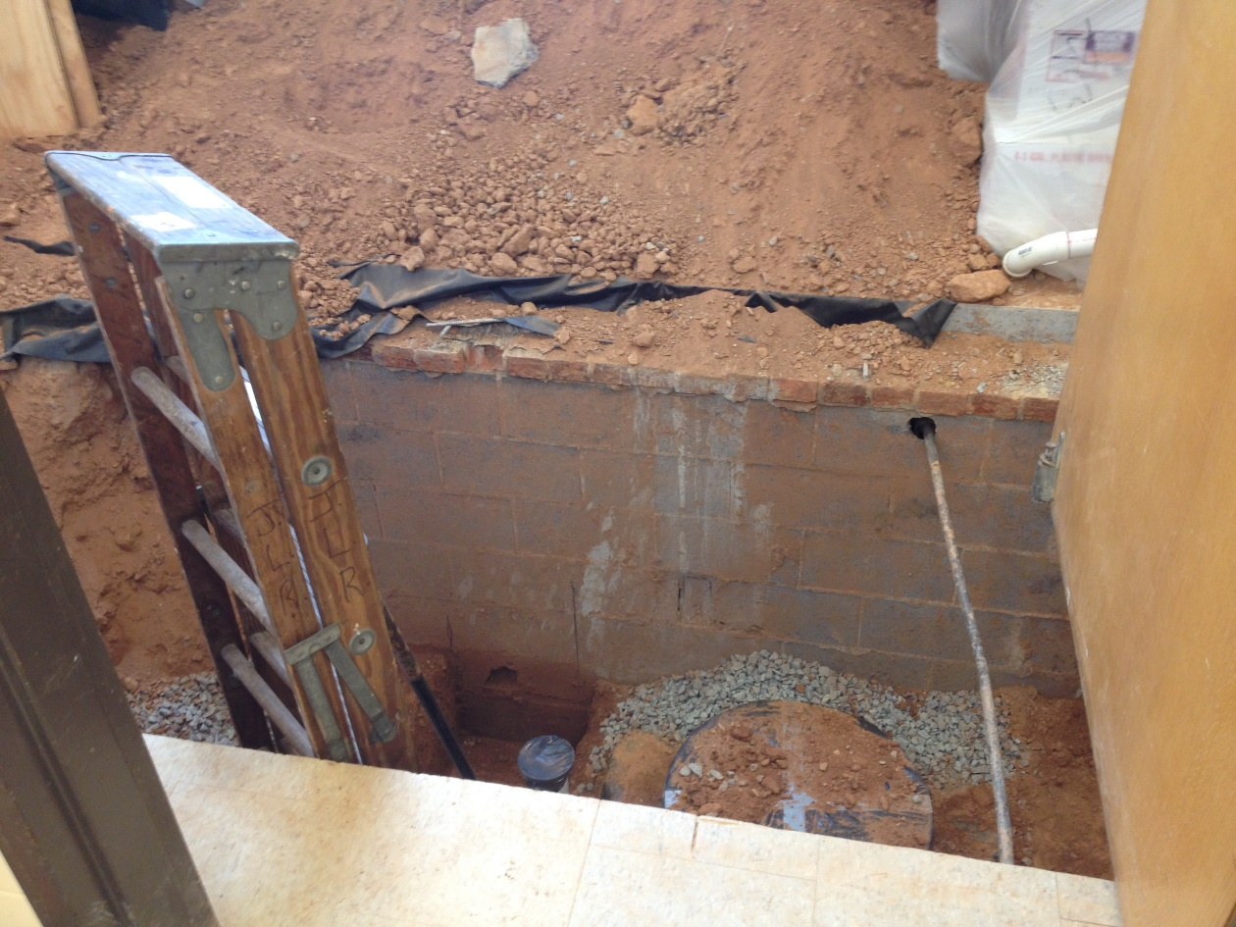
Unexpected Hazards

Slide 29
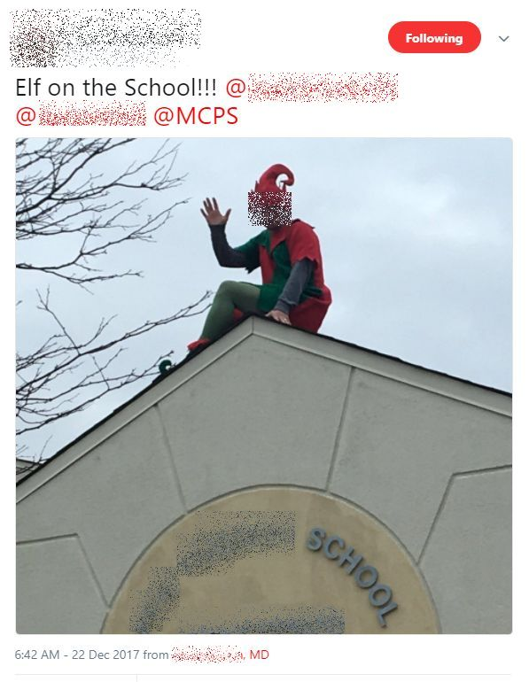
Unexpected Hazards

Slide 30
Questions?

